Slide 1
ORIZONT 2020
Depunerea online a
propunerii de proiect
Eveniment organizat de Ministerul Educației Naționale, Universitatea din Craiova
Craiova – 5-6 iunie 2014

Slide 3
Cum aplicam pentru o propunere de proiect in cadrul Programului Orizont 2020 ?

Slide 4
http://ec.europa.eu/research/participants/portal/desktop/en/home.html

Slide 5
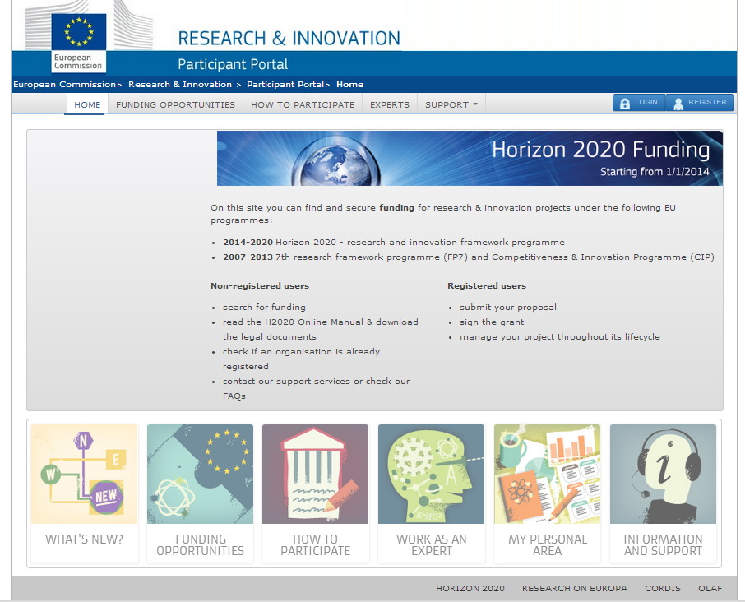

Slide 6
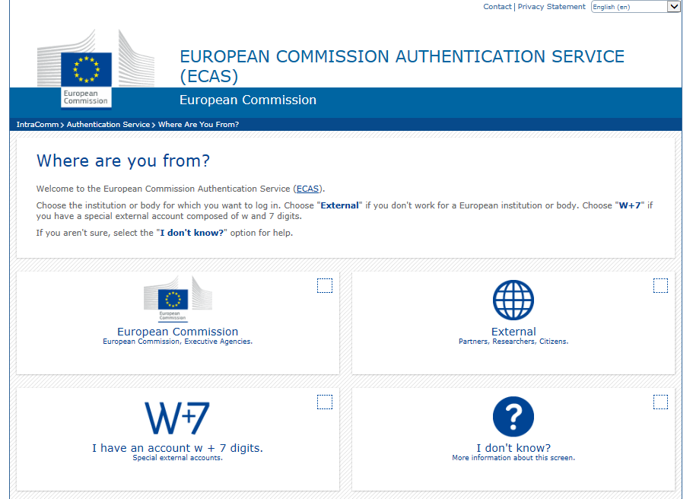

Slide 7
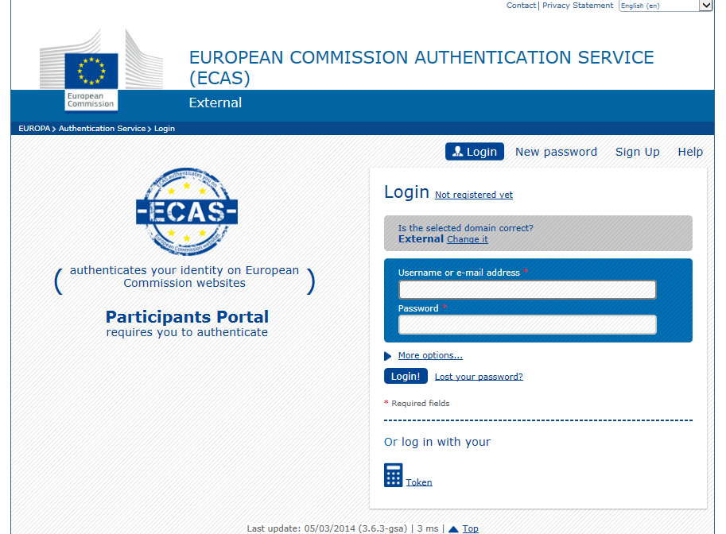

Slide 10
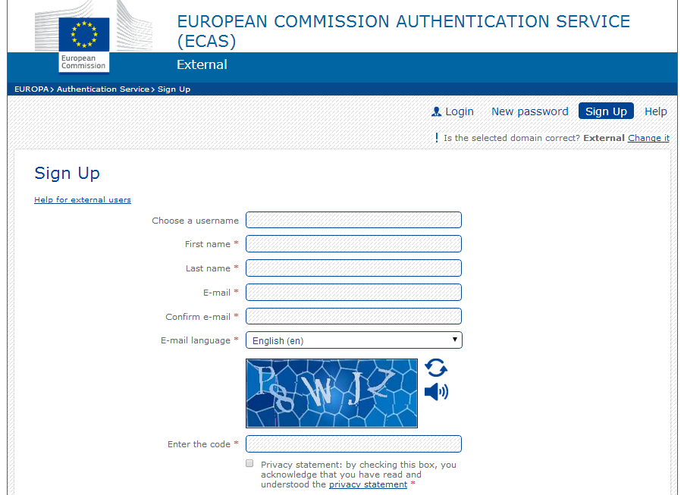

Slide 11
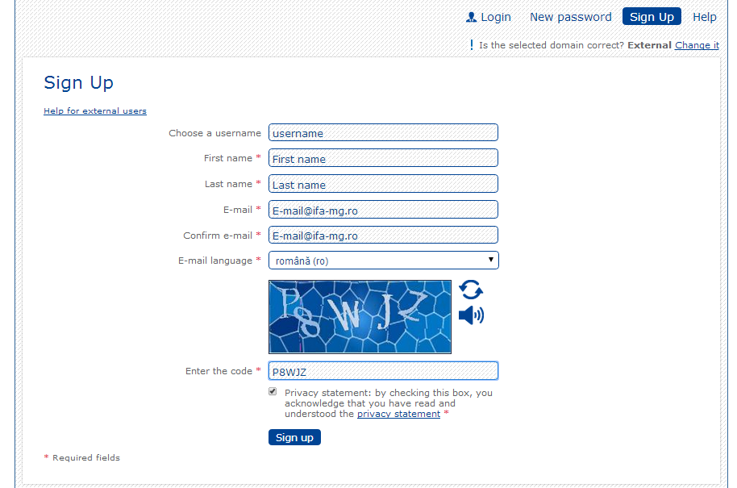

Slide 12
E-mail confirmare:
Dear subscriber,
Thank you for your interest in H2020, and for submitting your registration details. Please now activate your account by following the instructions below. You will then have full access to H2020 registered services.
Please copy and paste the (complete) following URL into your web browser:
LINK CONFIRMARE
......

Slide 14
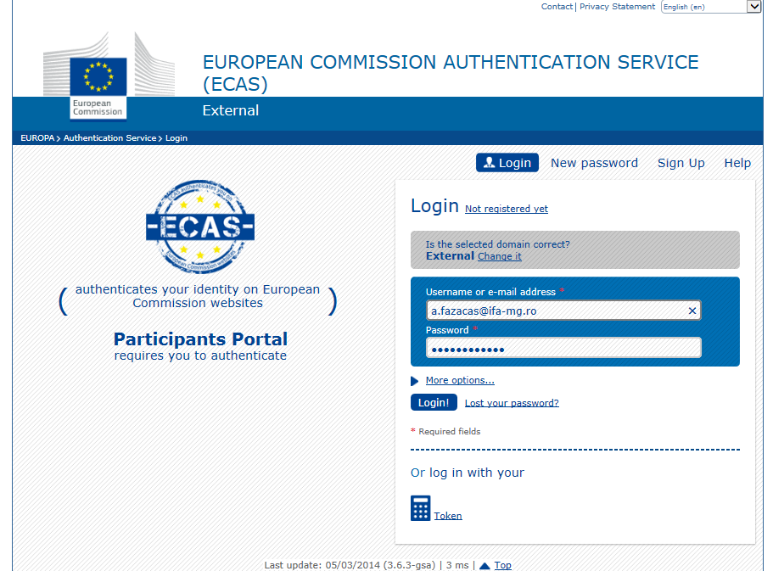

Slide 15
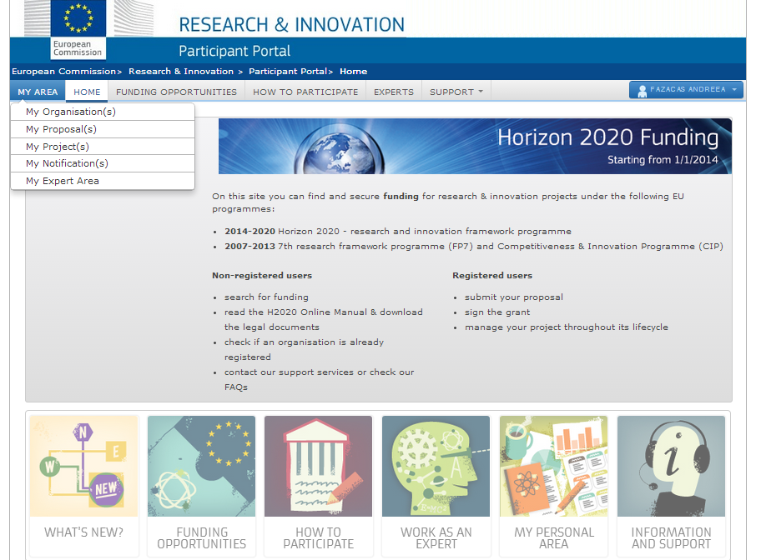

Slide 16
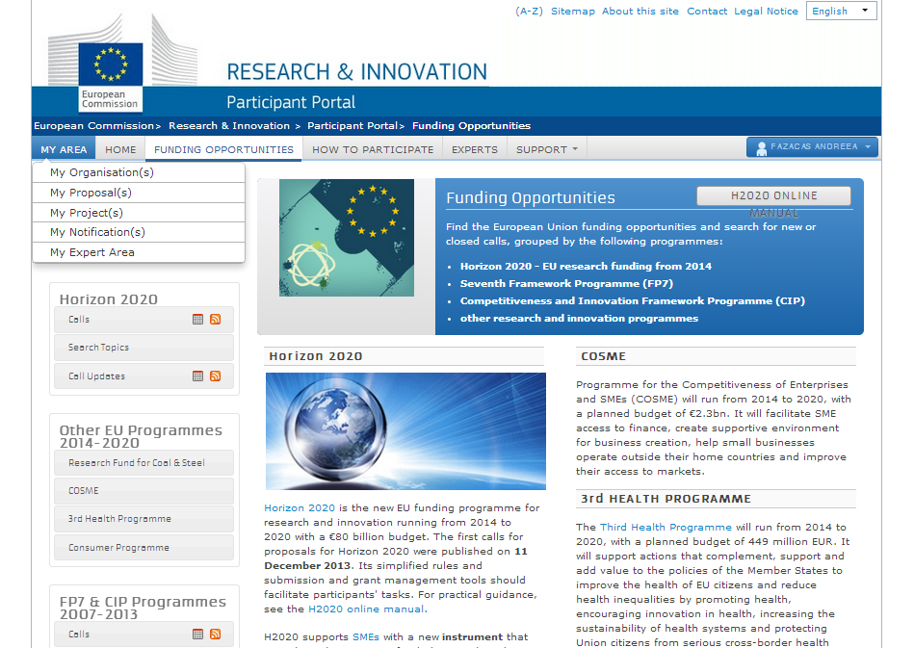

Slide 17
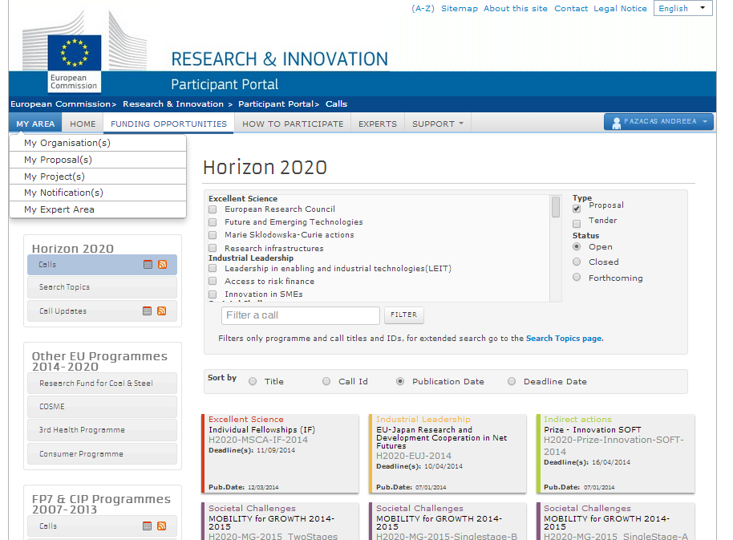

Slide 18
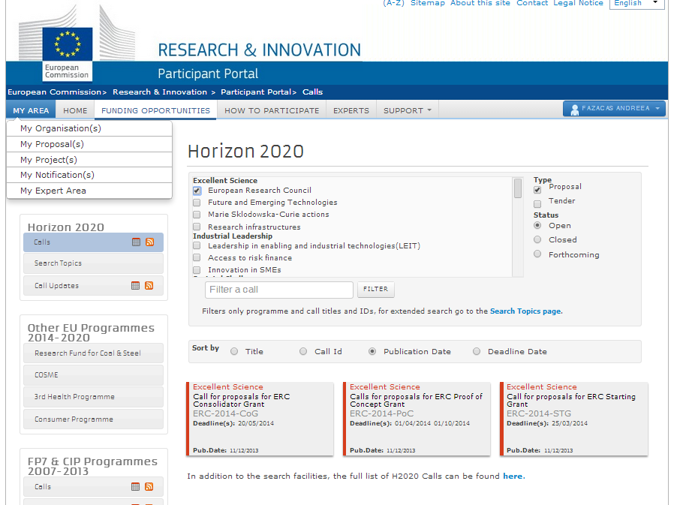

Slide 19
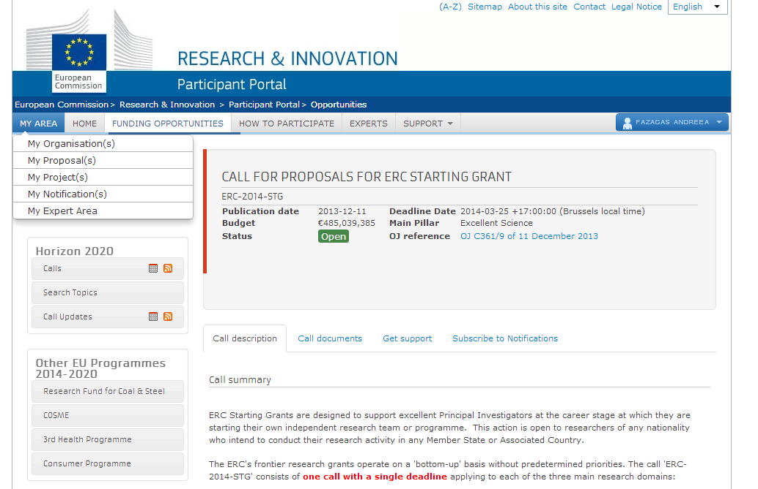

Slide 20
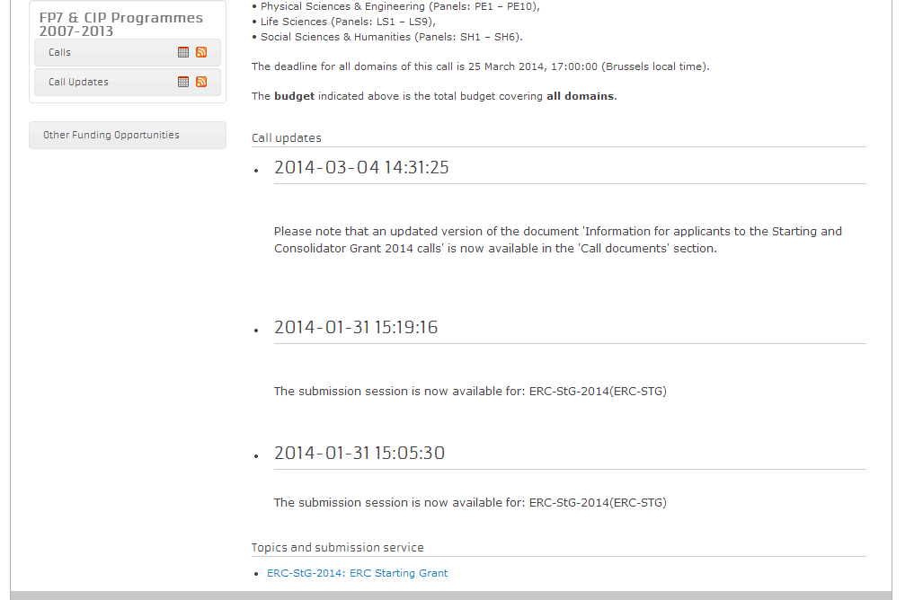

Slide 21
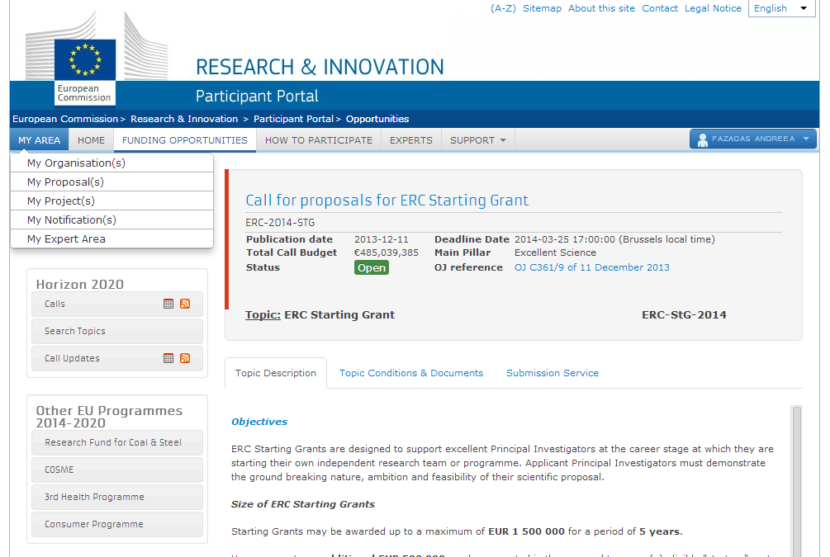

Slide 22
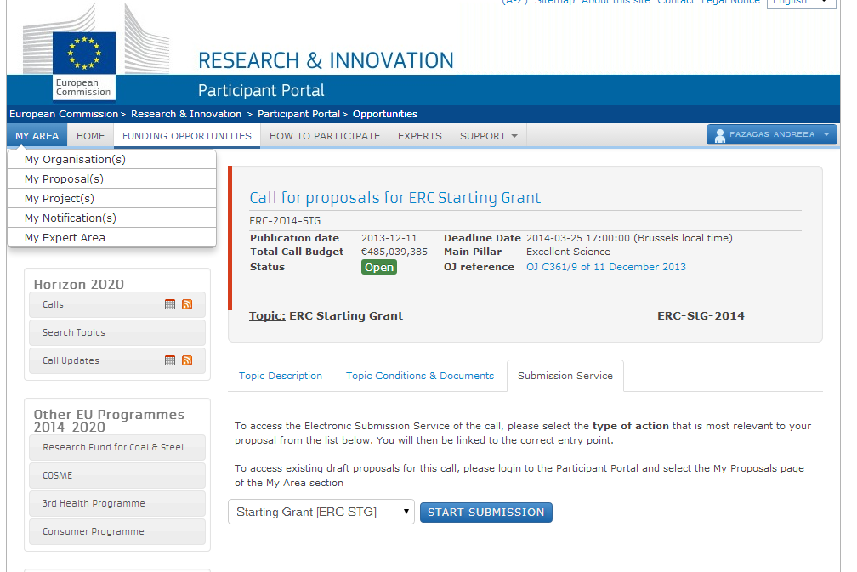

Slide 23
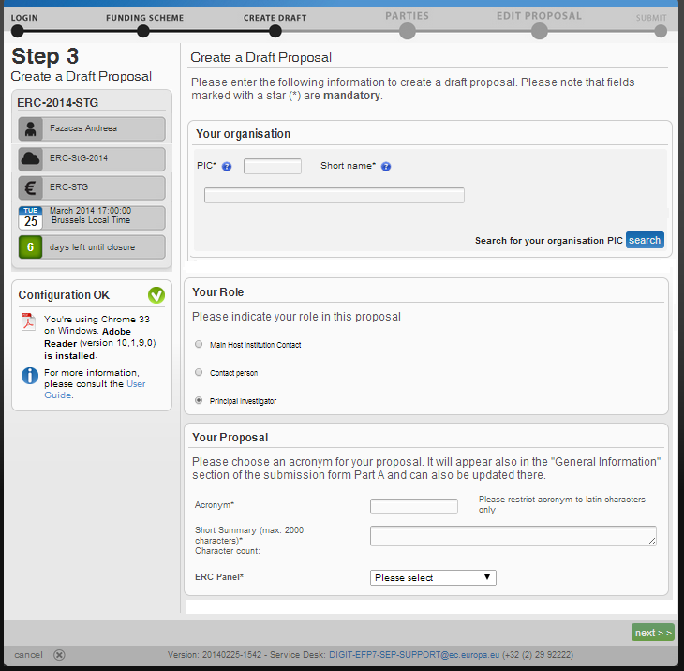

Slide 24
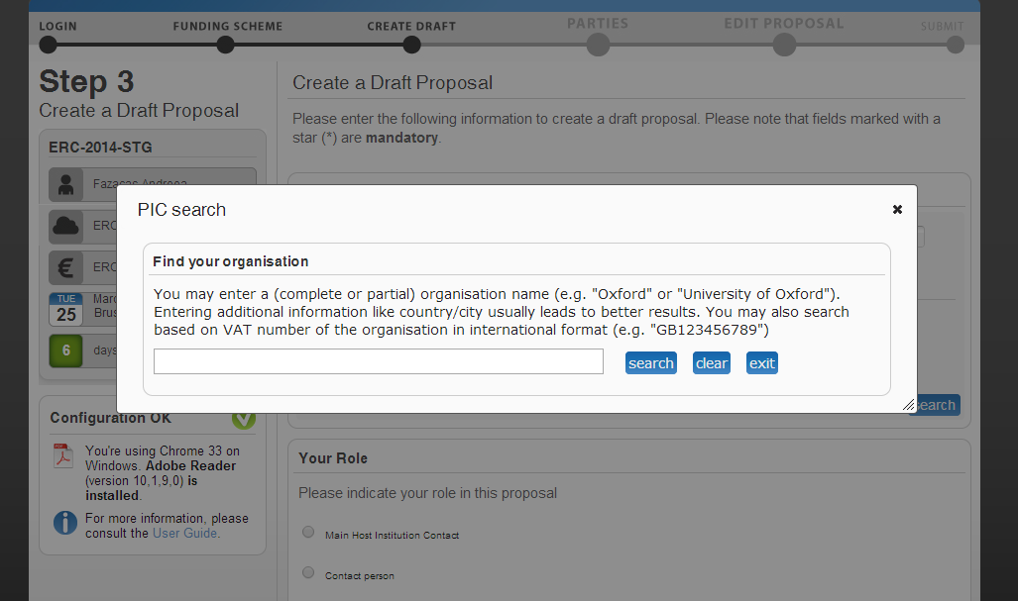

Slide 25
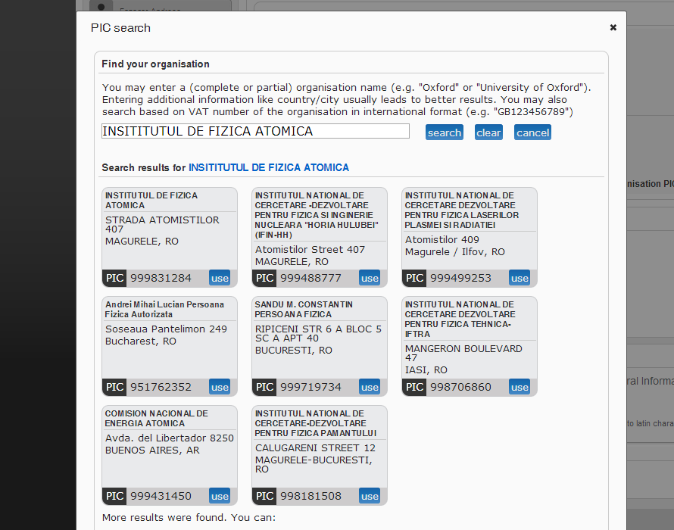

Slide 26
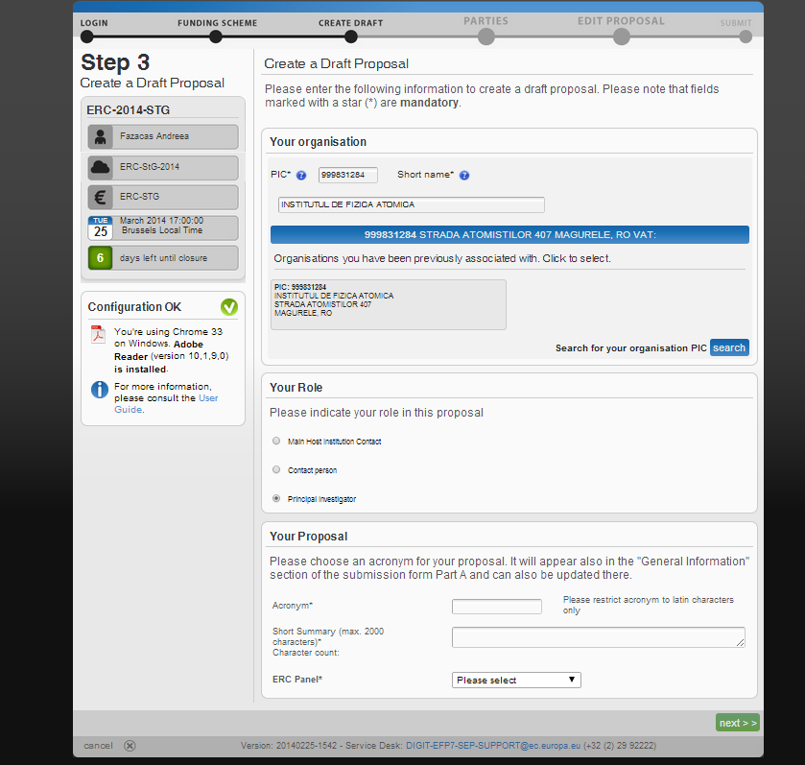

Slide 27
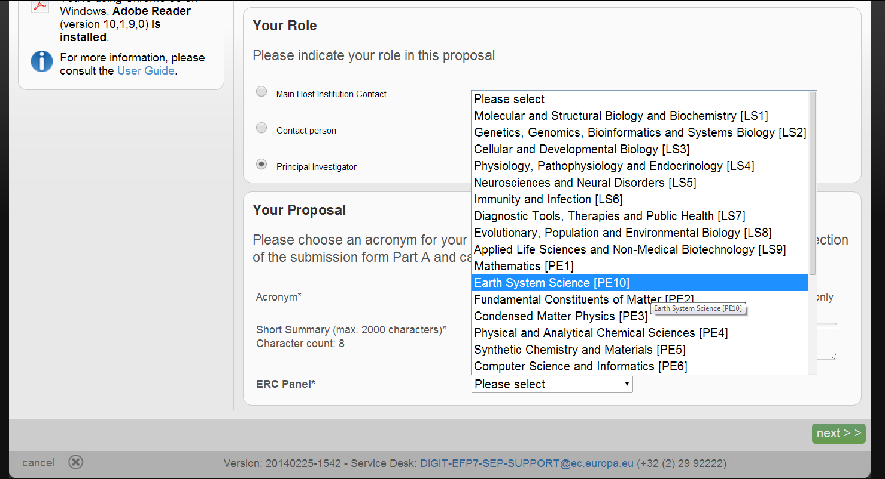

Slide 28
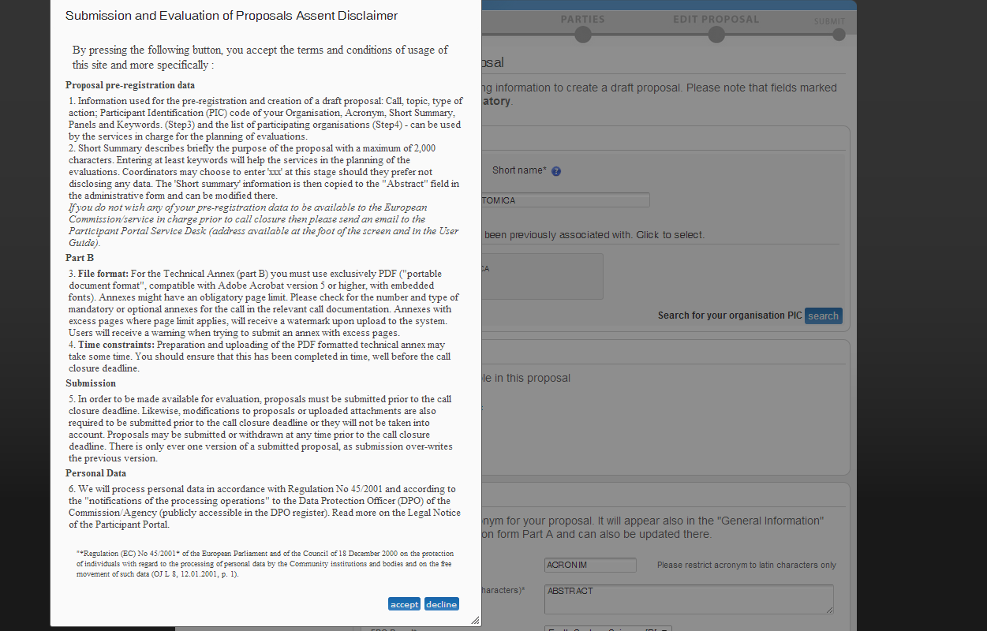

Slide 29
E-mail propunere
Dear Proposal Participant,
You have successfully created a draft proposal in the Participant Portal Submission System:
Proposal acronym: ACRONIM
Draft proposal ID: SEP-210152206 (a final Proposal ID will be assigned as soon as the proposal is submitted)
Call : ERC-2014-STG
Type of action: ERC-STG Topic: ERC-StG-2014
Call closure : 2014-03-25 17:00:00 Y
Your ECAS ID: nandreff
You can review, edit and submit your proposal at any time from My Proposals tab (link propunere) in the Participant Portal.
With kind regards,
European Commission - Participant Portal Submission System team

Slide 30
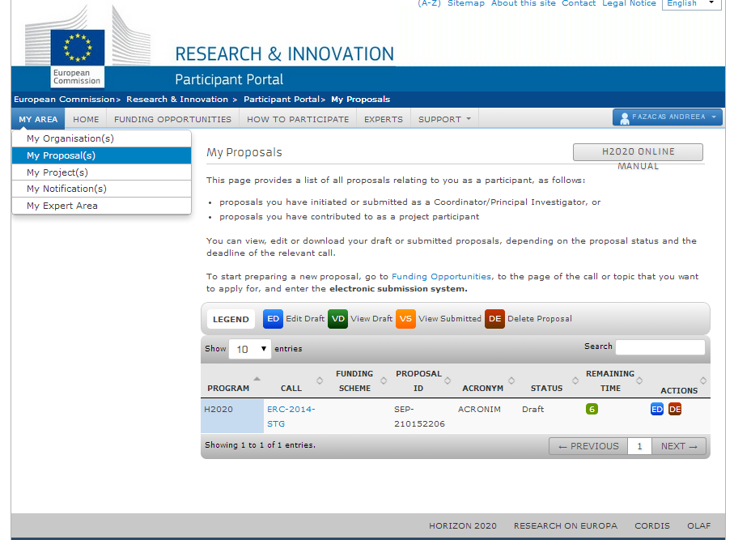

Slide 31
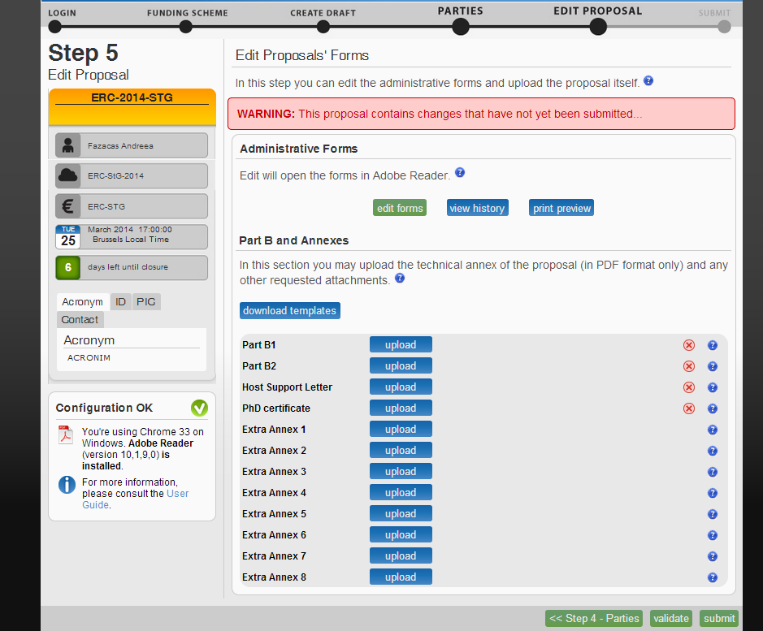

Slide 32
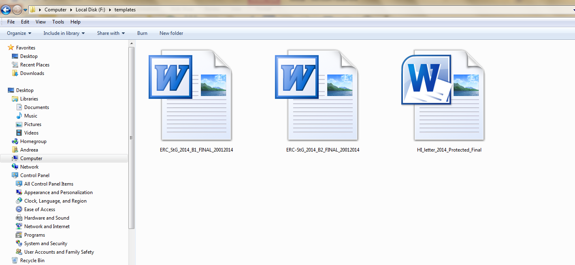

Slide 34
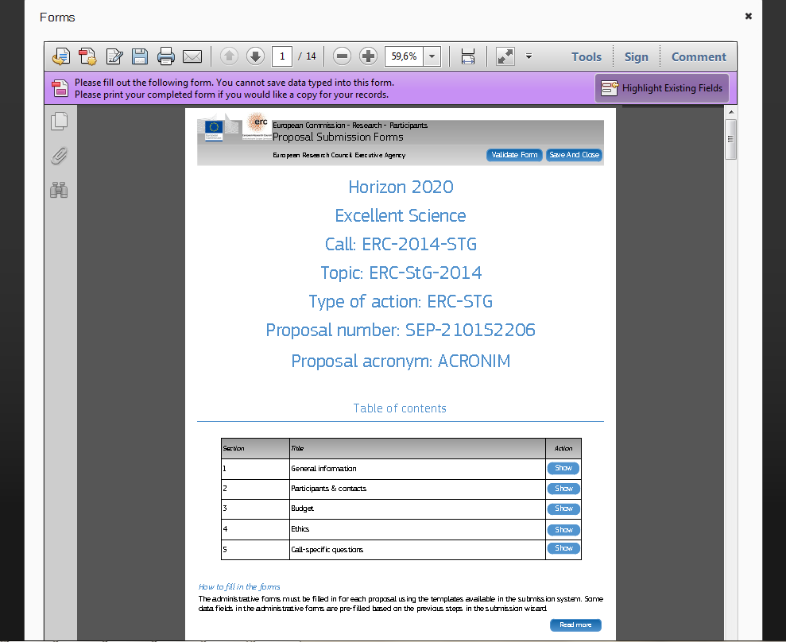

Slide 35
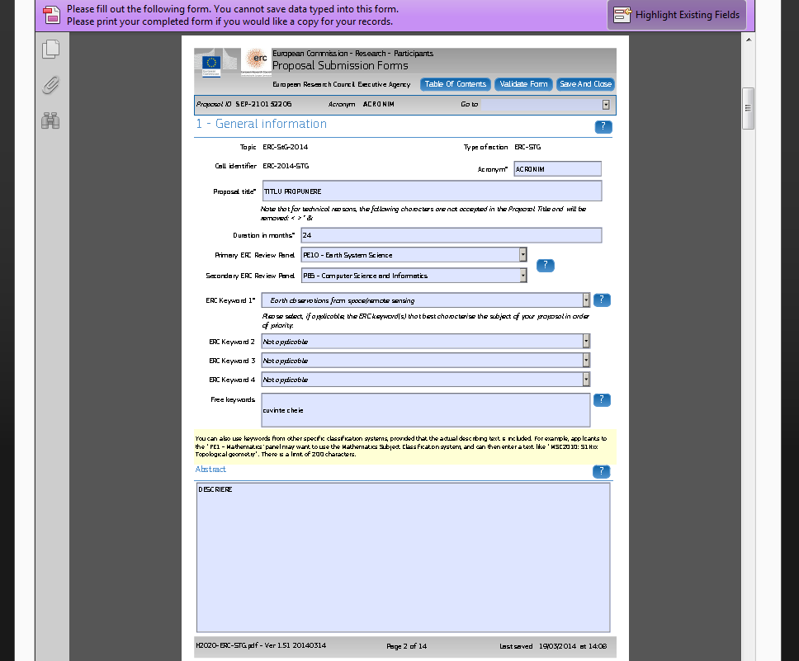

Slide 36
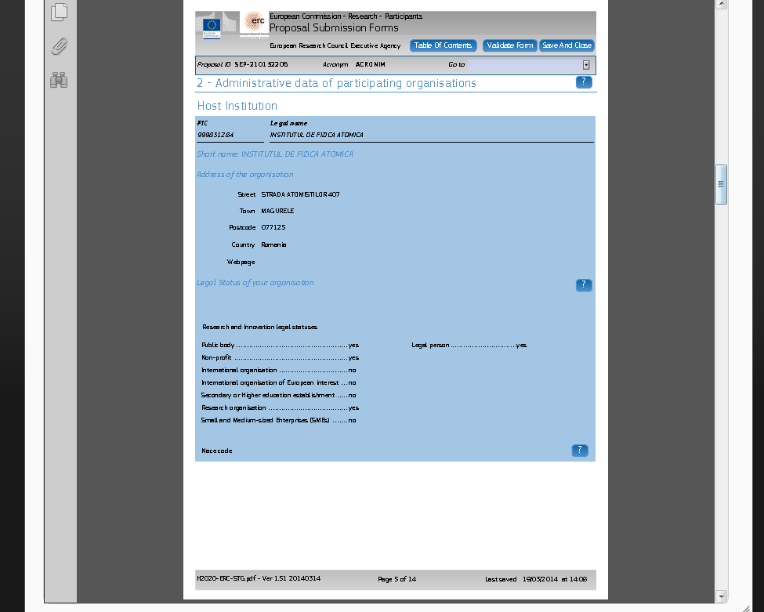

Slide 38
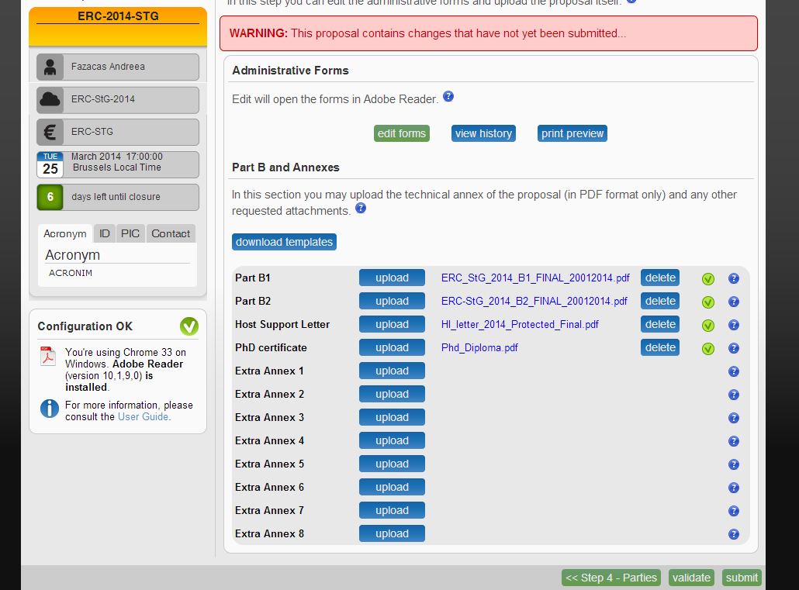

Slide 39
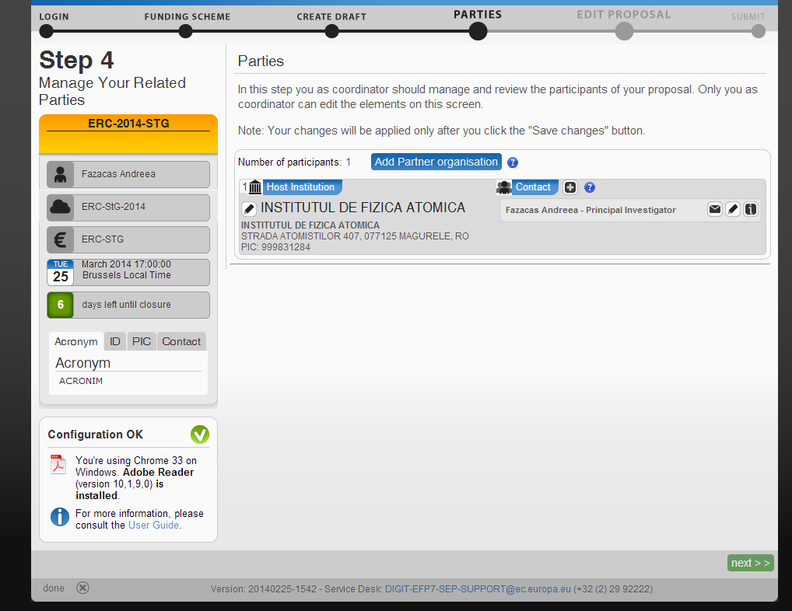

Slide 40
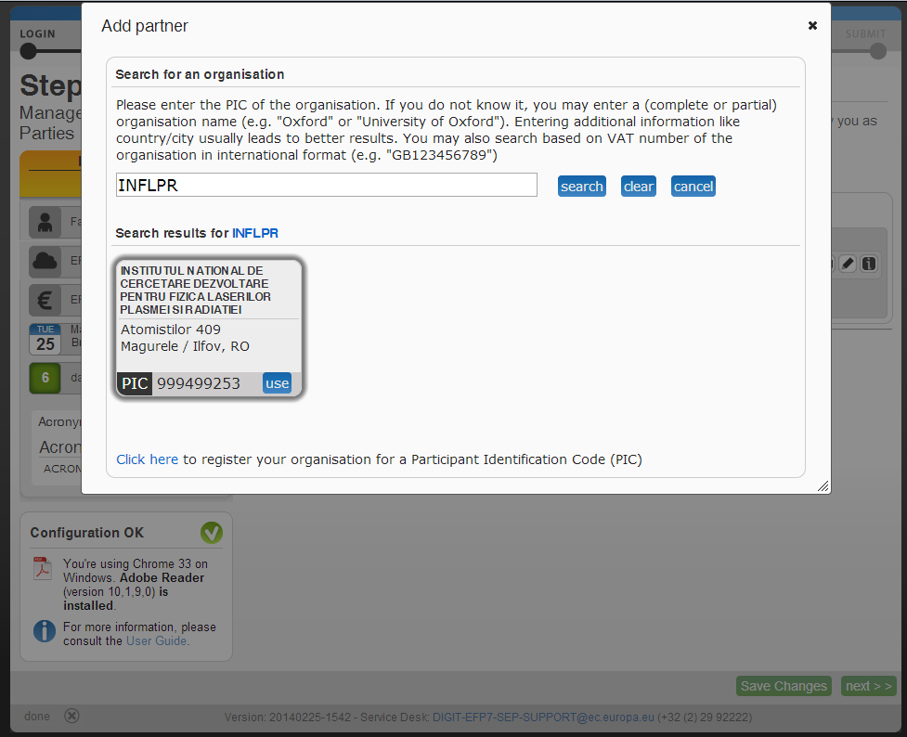

Slide 42
Va multumesc!
H2020
Contact: a.fazacas@ifa-mg.ro

