Slide 1
ORIZONT 2020
Evaluarea propunerilor de proiect în Orizont 2020
Eveniment organizat de Ministerul Educației Naționale, Universitatea din Craiova şi Enterprise Europe Network Craiova
Craiova, 05-06.06.2014

Slide 2
Steps
Evaluation
Eligibility
Admissibility

Slide 3
ADMISSIBILITY AND ELIGIBILITY
Once you have submitted a proposal, the Commission:
checks it is admissible (complete and properly put together) and eligible
asks independent experts to evaluate it.
Admissibility criteria
A proposal is admissible if it:
is submitted via the official online submission system before the call deadline
is complete – accompanied by the relevant administrative forms, proposal description and any supporting documents specified in the call
is readable, accessible and printable
Furthermore, your proposal must not exceed the maximum number of pages indicated in the proposal template. The system will warn you of the consequence of submitting over-long proposals. (Excess pages will be watermarked or truncated).
Eligibility criteria
A proposal is eligible if:
its contents are in line with the topic description in the call
it involves enough of the right participants and meets Standard eligibility criteria and any other eligibility conditions set out in the call or topic page
The conditions specific to Marie Sklodowska-Curie Actions (MSCA) are described in the MSCA section of the General Work Programme.
The conditions specific to European Research Council (ERC) grants are described in the ERC Work Programme: Starting Grant, Consolidator Grant and Advanced Grant , Proof of Concept Grant

Slide 4
AWARD CRITERIA
Experts will evaluate on the basis of following criteria:
Excellence
Impact
Quality and efficiency of the implementation
Templates of the forms that experts use to evaluate proposals are available on the topic conditions pages for each call. Horizon 2020 calls may have one or several topics each.

Slide 5
Description of Work (DoW)
B1. Concept and objectives, progress beyond state-of-the-art, S/T methodology and work plan
B.1.1 Concept and project objective(s)
B.1.2 Progress beyond the state of the art
B.1.3 S/T methodology and associated work plan
B.1.3.1 Overall strategy and general description
B.1.3.2 Timing of work packages and their components
B.1.3.3 Work package list /overview
B.1.3.4 Deliverables list
B.1.3.5 Work package descriptions
B.1.3.6 Efforts for the full duration of the project
B.1.3.7 List of milestones and planning of reviews
B2. Implementation
B.2.1 Management structure and procedures
B.2.2 Beneficiaries
B.2.3 Consortium as a whole
[Sub-contracting]
[Funding for beneficiaries from third countries]
[Additional beneficiaries / Competitive calls]
[Third parties]
B.2.4 Resources to be committed
B3. Potential impact
B.3.1 Strategic impact
B.3.2 Plan for the use and dissemination of foreground
If applicable [Contributions to standards]
[Contribution to policy developments]
[Risk assessment and related communication strategy]
Quality and efficiency of the implementation
Excellence
Impact

Slide 6
Description of Work (DoW)
B1. Concept and objectives, progress beyond state-of-the-art, S/T methodology and work plan
B.1.1 Concept and project objective(s)
B.1.2 Progress beyond the state of the art
B.1.3 S/T methodology and associated work plan
B.1.3.1 Overall strategy and general description
B.1.3.2 Timing of work packages and their components
B.1.3.3 Work package list /overview
B.1.3.4 Deliverables list
B.1.3.5 Work package descriptions
B.1.3.6 Efforts for the full duration of the project
B.1.3.7 List of milestones and planning of reviews
Quality and efficiency of the implementation

Slide 7
Description of Work (DoW)
B2. Implementation
B.2.1 Management structure and procedures
B.2.2 Beneficiaries
B.2.3 Consortium as a whole
[Sub-contracting]
[Funding for beneficiaries from third countries]
[Additional beneficiaries / Competitive calls]
[Third parties]
B.2.4 Resources to be committed
Excellence

Slide 8
Description of Work (DoW)
B3. Potential impact
B.3.1 Strategic impact
B.3.2 Plan for the use and dissemination of foreground
If applicable [Contributions to standards]
[Contribution to policy developments]
[Risk assessment and related communication strategy]
Impact

Slide 9
scores
Experts score each award criterion on a scale from 0 to 5:
0 Proposal does not meet the criterion at all or cannot be assessed due to missing or incomplete information
1 Poor – serious weaknesses
2 Fair – goes some way to meeting criterion, but with significant weaknesses
3 Good – but with a number of shortcomings
4 Very good – but with a small number of shortcomings
5 Excellent – meets criterion in every relevant respect. Any shortcomings are minor
The maximum overall score is thus 15 (3x5), unless a weighting is applied.

Slide 10
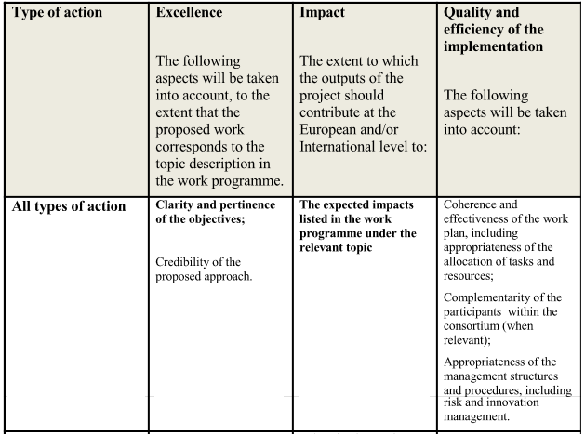
AWARD CRITERIA

Slide 11
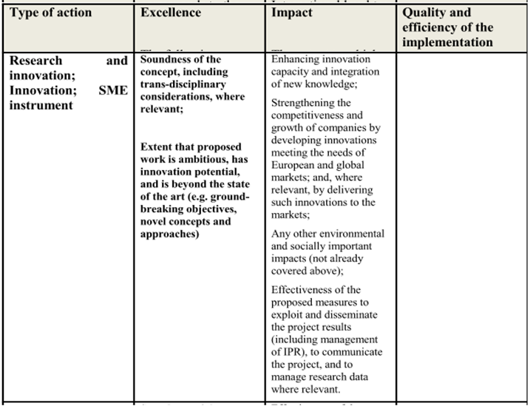
AWARD CRITERIA

Slide 12
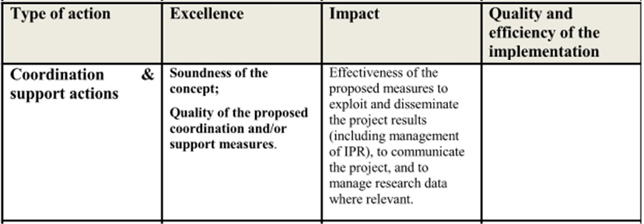
AWARD CRITERIA

Slide 13
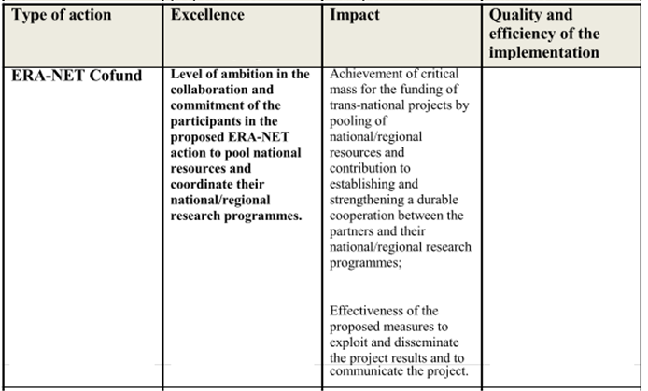
AWARD CRITERIA

Slide 14
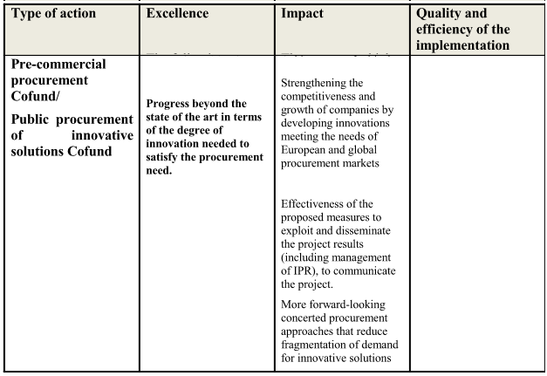
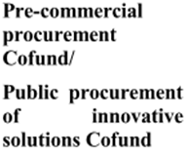
AWARD CRITERIA

Slide 15
AWARD CRITERIA
Note
Unless otherwise specified in the call conditions:
(a) Evaluation scores will be awarded for the criteria
For full proposals, each criterion will be scored out of 5.
(b) For Innovation actions and the SME instrument (phases 1 and 2), to determine the ranking, the score for the criterion ‘impact’ will be given a weight of 1.5.
The threshold for individual criteria will be 3.
The overall threshold, applying to the sum of the three individual scores, will be 10.

Slide 16
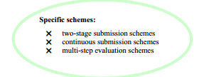
AWARD
CRITERIA
Specific cases:
For the evaluation of first-stage proposals under a two-stage submission procedure, only the criteria ‘excellence’ and ‘impact’ will be evaluated.
The threshold for both individual criteria will be 4.
For two-stage submission schemes, you must submit a ‘short outline proposal’ for the first stage and you will be invited to submit your ‘full proposal’ for the second stage, if you pass the first-stage evaluation.
The full proposal must be consistent with the short outline proposal and may not differ substantially.
Some calls may be continuously open for submission at any time.
In these cases, the call will set intermediate or final closure dates and specify whether:
the evaluation of proposals will be carried out within one month of that date;
proposals will be evaluated individually as they arrive and ranked after the next intermediate or final closure date.
If you miss an intermediate closure date, the proposal will be evaluated in the next evaluation session.

Slide 17
AWARD CRITERIA
Priority order for proposals with the same score
Unless the call conditions indicate otherwise, the following method will be applied.
As part of the evaluation by independent experts, a panel review will recommend one or more ranked lists for the proposals under evaluation, following the scoring systems indicated above.
A ranked list will be drawn up for every indicative budget shown in the call conditions.
If necessary, the panel will determine a priority order for proposals which have been awarded the same score within a ranked list. Whether or not such a prioritisation is carried out will depend on the available budget or other conditions set out in the call fiche.

Slide 18
AWARD CRITERIA
Priority order for proposals with the same score
The following approach will be applied successively for every group of ex aequo proposals requiring prioritisation, starting with the highest scored group, and continuing in descending order:
Proposals that address topics not otherwise covered by more highly-ranked proposals, will be considered to have the highest priority.
These proposals will themselves be prioritised according to the scores they have been awarded for the criterion excellence.
When these scores are equal, priority will be based on scores for the criterion impact.
In the case of Innovation actions, and the SME instrument (phases 1 and 2), this prioritisation will be done first on the basis of the score for impact, and then on that for excellence.

Slide 19
AWARD CRITERIA
Priority order for proposals with the same score
If necessary, any further prioritisation will be based on the following factors, in order:
size of budget allocated to SMEs;
gender balance among the personnel named in the proposal who will be primarily responsible for carrying out the research
and/or innovation activities.
If a distinction still cannot be made, the panel may decide to further prioritise by considering how to enhance the quality of the project portfolio through synergies between projects, or other factors related to the objectives of the call or to Horizon 2020 in general. These factors will be documented in the report of the Panel.
(iii) The method described in (ii) will then be applied to the remaining ex aequos in the group.

Slide 20
GENDER
AS CROSS-CUTTING ISSUE
Commitment to gender equality across all H2020 programmes
Main objectives integrated in the R&I cycle:
Gender balance in research teams at all levels
Gender balance in decision making
Gender dimension in research and innovation content involving human beings

Slide 21
GENDER
AS CROSS-CUTTING ISSUE
Commitment to gender equality across all H2020 programmes
Emphasis on gender balance throughout the project cycle – Streamlined approach for all programmes
Gender dimension to be adressed at proposal stage
e.g. composition of research teams /advisory boards,
gender dimension in research content,
encouragement to include trainings on gender in ITN
Evaluators take gender dimension into account
Signature of GA = commitment to aim for gender balance
Obligatory project reporting includes achievements in terms of gender balance

Slide 22
ETHICS REVIEW
Research compliant with ethical principles
Response to citizens’ demand
Challenge of media
Legal base:
Seventh Framework Programme (Decision N° 1982/2006/EC), Article 6 (1§):
No grant is given if may
contravene ethical legislation or regulations
(EU and/or national legislation and regulation)
Areas Excluded From Funding
• Human cloning for reproductive purposes.
• Modify the genetic heritage of human beings. (except research relating to cancer treatment of the gonads)
• Create human embryos solely for the purpose of research or stem cell procurement.

Slide 23
ETHICS REVIEW
What is expected from the applicant?
Submits an ethics table and annex together with the application. http://cordis.europa.eu/fp7/ethics_en.html
Describes the potential ethical aspects of the proposed research regarding its objectives, the methodology and the possible implications of the results.
Explains how the ethical requirements set out in the work programme will be fulfilled.
Indicates how the proposal meets the national legal and ethical requirements of the country where the research is performed, ensuring compliance with the EU ethics framework.
Are encouraged to indicate which particular authorisations may be needed.

Slide 24
ETHICS REVIEW
Ethics check list
Informed Consent [PDF]
Does the proposal involve children?
Does the proposal involve patients or persons not able to give consent?
Does the proposal involve adult healthy volunteers?
Does the proposal involve Human Genetic Material?
Does the proposal involve Human biological samples?
Does the proposal involve Human data collection?
Research on Human embryos/foetus [DOC]
Does the proposal involve Human Embryos?
Does the proposal involve Human Foetal Tissue/Cells?
Does the proposal involve Human Embryonic Stem Cells?
Privacy [DOC]
Does the proposal involve processing of genetic information or personal data (eg. health, sexual lifestyle, ethnicity, political opinion, religious or philosophical convinction)?
Does the proposal involve tracking the location or observation of people?

Slide 25
ETHICS REVIEW
Ethics check list
Research on Animals [DOC]
Does the proposal involve research on animals?
Are those animals transgenic small laboratory animals?
Are those animals transgenic farm animals?
Are those animals cloning farm animals?
Are those animals non-human primates?
Research Involving Developing Countries [PDF]
Use of local resources (genetic, animal, plant, etc.)?
Benefit to local community (capacity building ie access to healthcare, education, etc. )
Dual Use [DOC]
Resarch having potential military/terrorist application

Slide 26
EVALUATION PROCEDURE
The evaluation procedure is described in detail in the Guide for proposal submission and evaluation.
Each full proposal is evaluated by at least three experts, but in many cases more experts are needed who know about the full range of disciplines and sectors covered by the proposal.
For the first stage of two-stage procedures a minimum of two experts may be used in certain cases.
Individual evaluation
Experts work individually. They give a score for each criterion, with explanatory comments. These are communicated to you via the Participant Portal, in an Evaluation Summary Report (ESR).
Consensus group
After carrying out an individual evaluation, an expert will join other experts who have evaluated the same proposal in a consensus group, to agree on a common position, including comments and scores.
Each group is assisted by a moderator who seeks a consensus, impartially and ensures that each proposal is evaluated fairly, according to the evaluation criteria
The moderator is normally a Commission official.
Panel review
If there are insufficient funds to award grants to all proposals that achieve a qualifying score in the evaluation, a review panel will: review the scores and comments for all proposals within a call to check for consistency across the evaluations and if necessary, propose a new set of marks or revise comments, and resolve cases where evaluators were unable to agree.

Slide 27
dcf

Slide 29
SUCCES !
Corina ABRAHAM-BARNA
c.g.abraham.barna@gmail.com

