Slide 1
ELI-NP Team, March 5, 2013

Slide 2
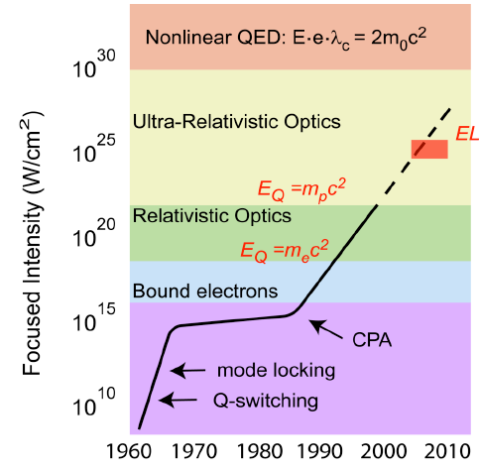
Extreme Light Infrastructure (ELI)
Gerard Mourou 1985: Chirped Pulse Amplification (CPA)

Slide 3
Radiation Pressure Acceleration RPA
Electrons and ions accelerated
at solid state densities 10²⁴e cm⁻³
(Classical beam densities 10⁸e cm⁻³ )
E~ I _{laser}

Slide 4
Extreme Light Infrastructure
2006 – ELI on ESFRI Roadmap
ELI-PP 2007-2010 (FP7)
ELI-Beamlines (Czech Republic)
ELI-Attoseconds (Hungary)
ELI-Nuclear Physics (Romania)
ELI-DC (Delivery Consortium): 2010
Legal entity: April 2013
Czech Republic, Hungary, Romania, Italy, Germany, UK
4

Slide 5
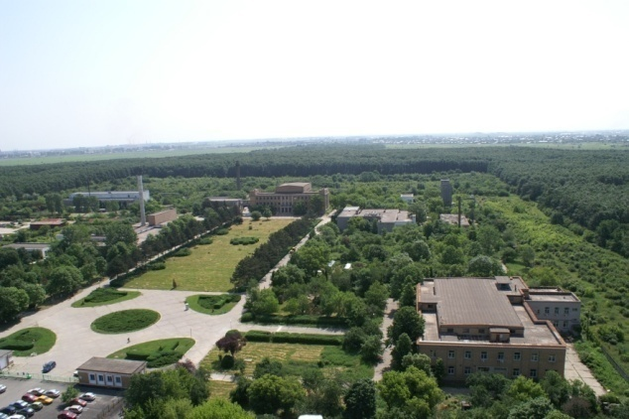
Bucharest-Magurele
National Physics Institutes
NUCLEAR
Tandem accelerators Cyclotrons
γ – Irradiator
Advanced Detectors
Biophysics
Environmental Physics
Radioisotopes
BUCHAREST
ring rail/road
ELI-NP
Lasers
Plasma
Optoelectronics
Material Physics
Theoretical Physics
Particle Physics
ELI-NP

Slide 6
ELI-NP Milestones
January 2012: Project submitted to the EC
July 2012: Romanian Government Decision
Construction of the New Research Infrastructure ELI-NP: 293 M€
September 2012: EC Project Approval
European Regional Development Fund
Financial Support (83%) of the First phase (2012-2015) 180 M€
Second Phase: 2015 - 2018
December 2012: Contract with Romanian Managing Authority
6

Slide 7
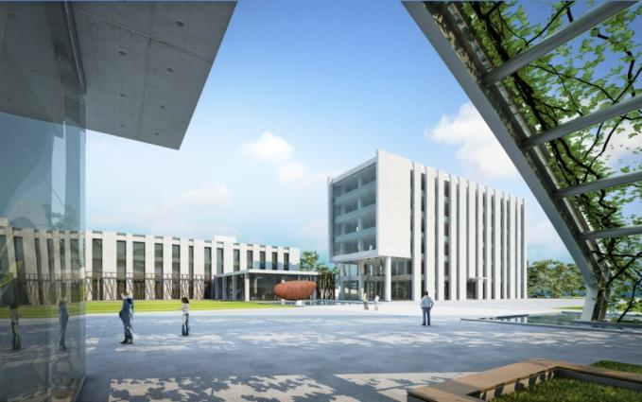
ELI-Nuclear Physics
Large equipments:
High power laser system, 2 x 10PW maximum power
Gamma Beam System
Scientific program:
Nuclear Physics experiments
to characterize laser – target interaction
Photonuclear reactions
Exotic Nuclear Physics and astrophysics
Applied Research
7

Slide 8
Applied Research at ELI – NP
Laser-produced charged particle beams may become an attractive alternative for large scale conventional facilities (10¹⁵ more intense)
High Resolution, high Intensity electron, positron, X-Ray and γ Beams
- Radioscopy and Tomography
- Materials research in high intensity radiation fields
Applications of Nuclear Resonance Fluorescence
- Management of sensitive nuclear materials
- New production techniques for radioisotopes for medical use
8

Slide 9
Project implementation
2010 2011 2012 2013 2014 2015
White Book (Scientific Case)
Feasibility Study
Preparation of the Application
E.C. Evaluation & Approval
Building - Preparation
Building - Construction
Major Eqp. - Tender
Major Eqp.– Constr, Install
Experimental set-ups
Recruitment
2017
9

Slide 10
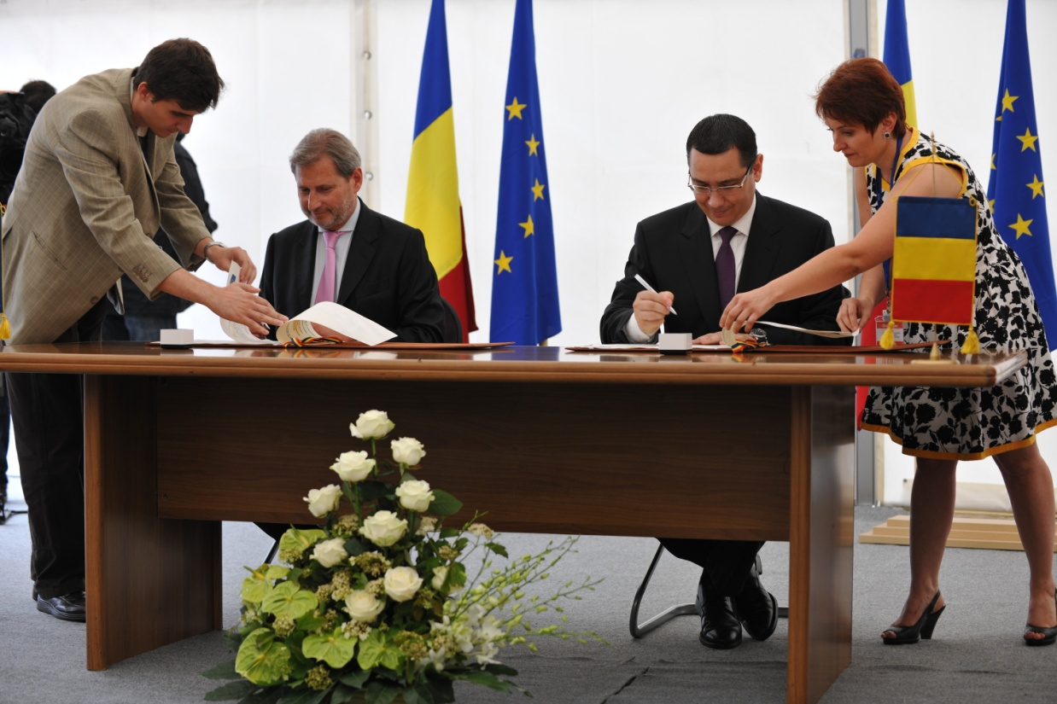
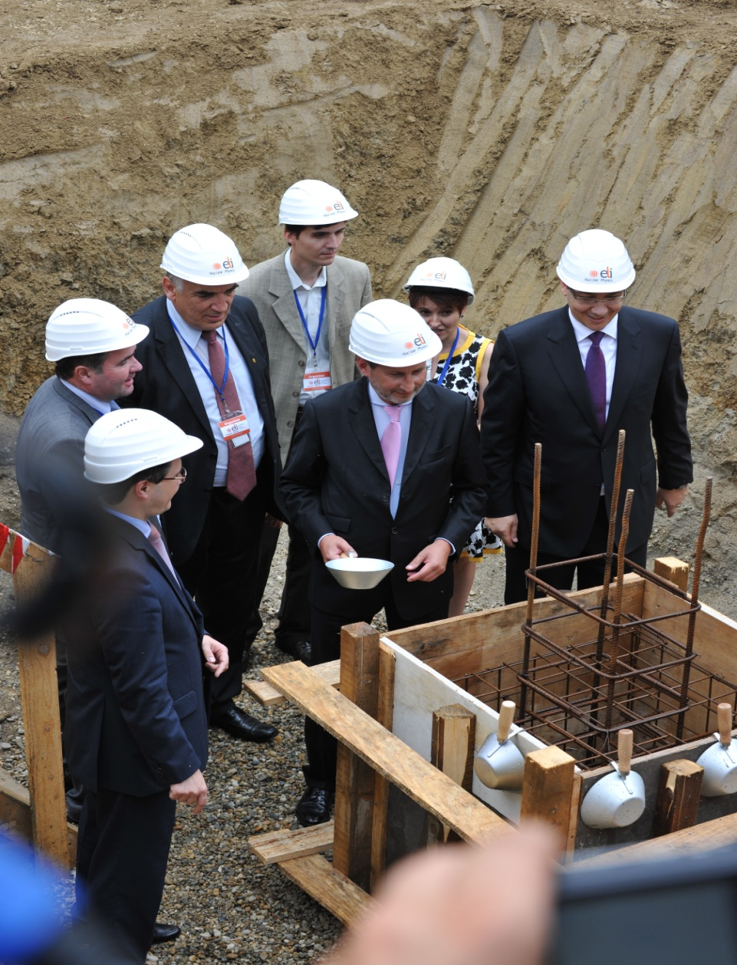
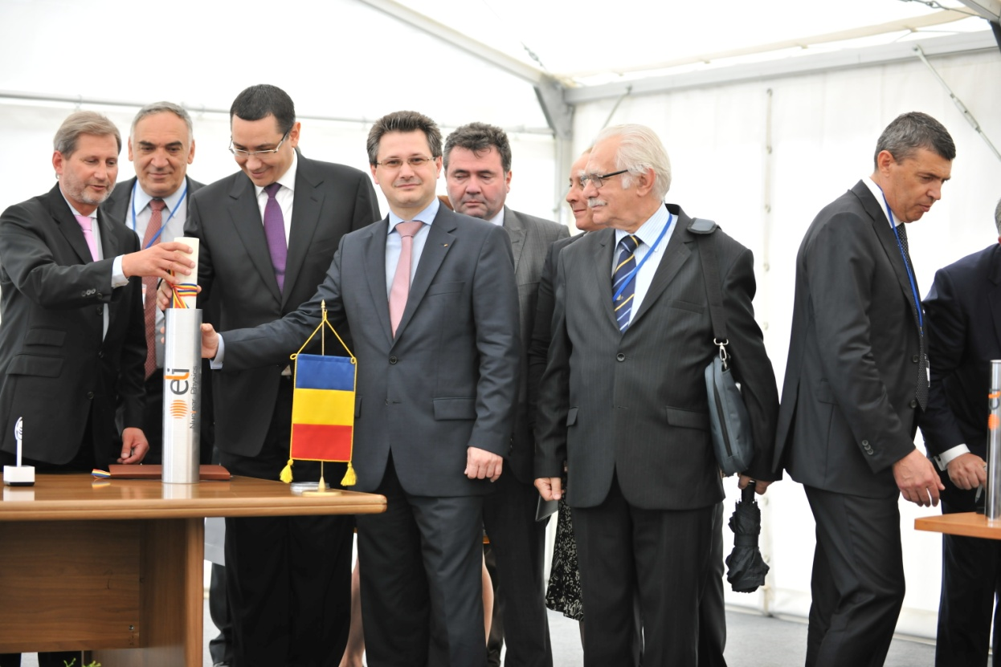
June 14th, 2013

Slide 11
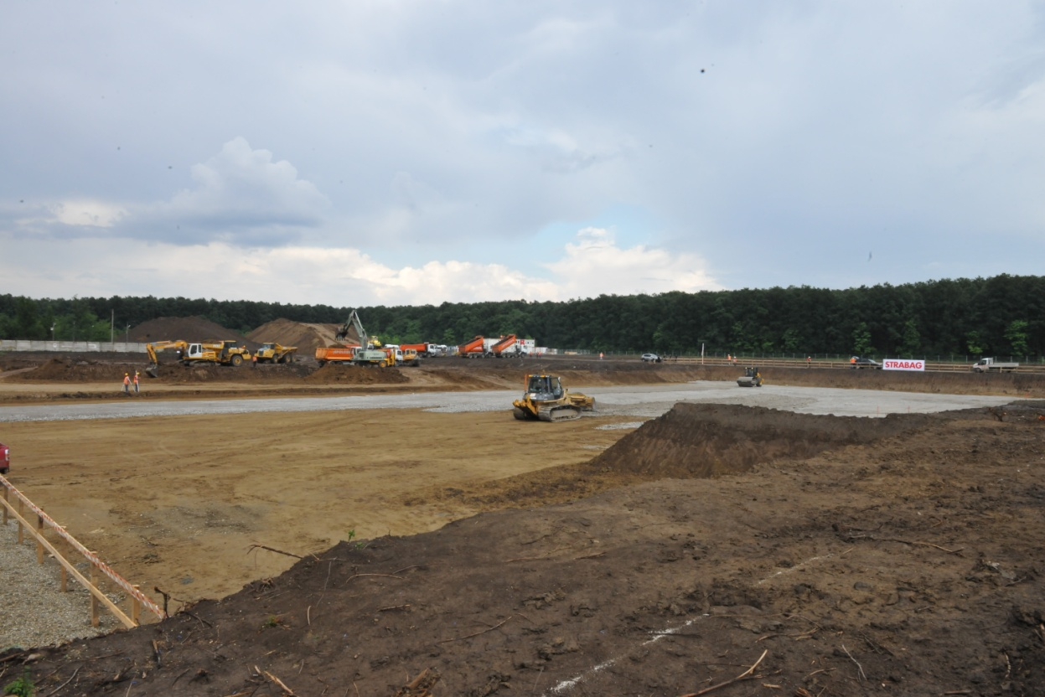
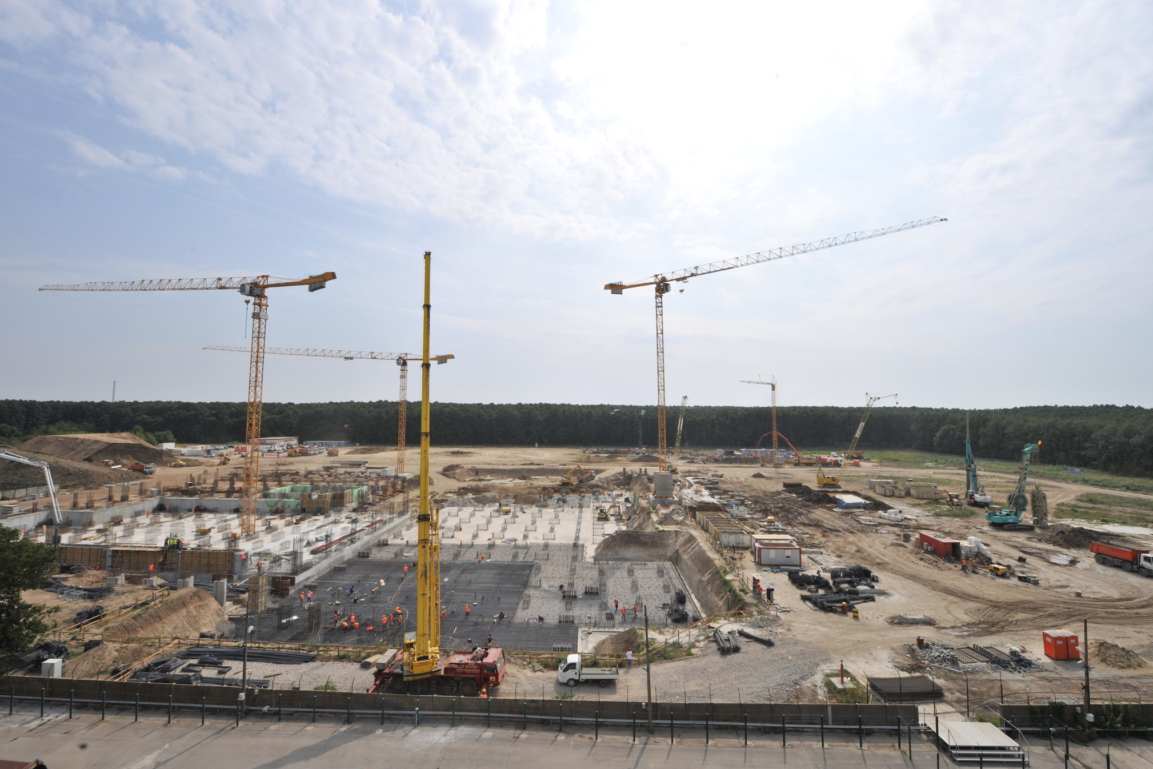
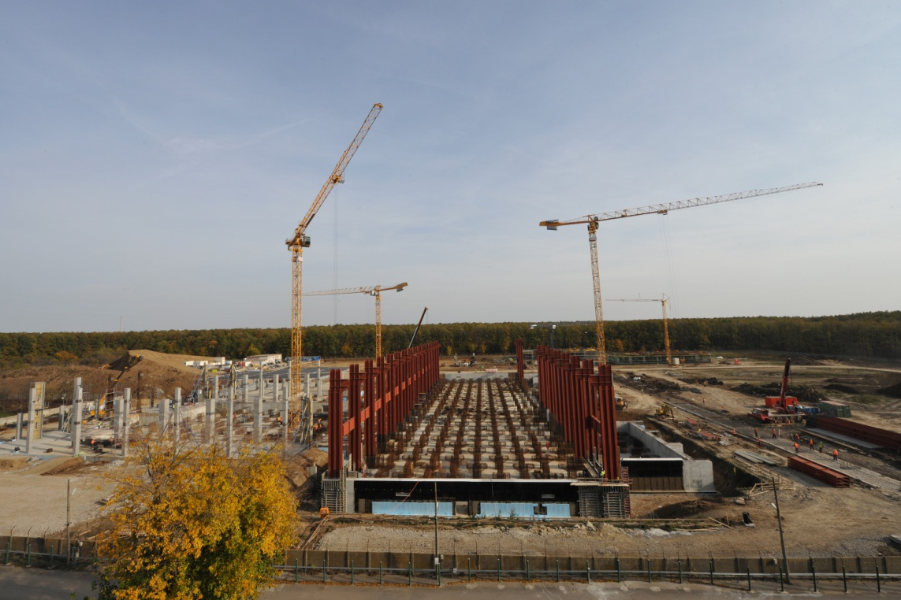
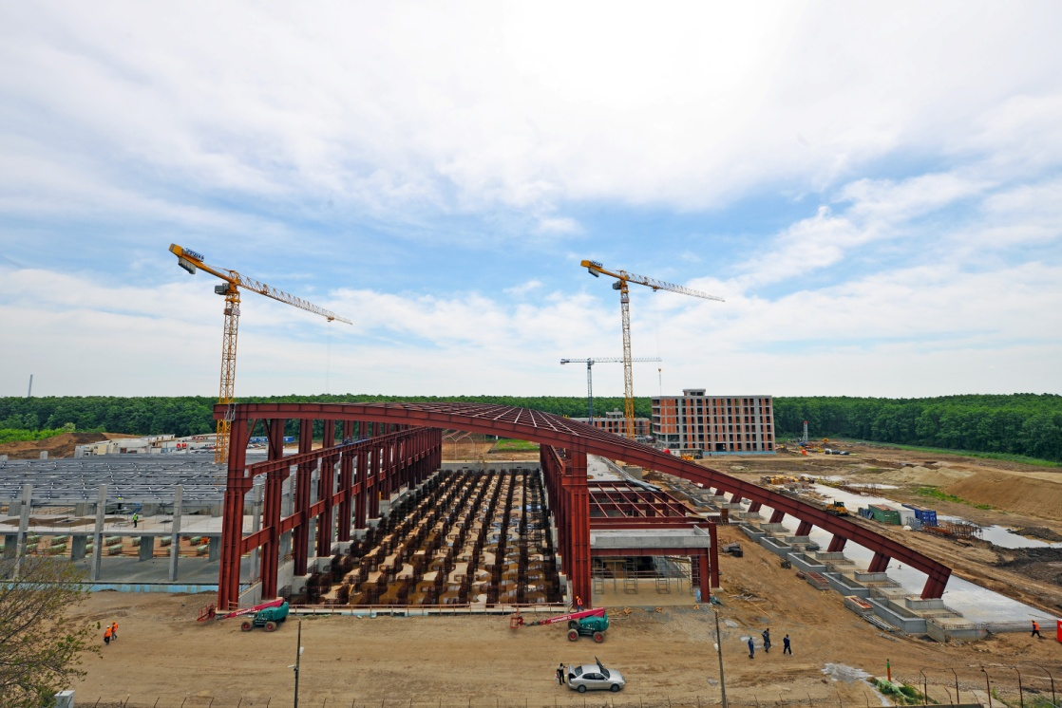
June 14, 2013
August 23, 2013
October 31, 2013
May 12,2014
May 12, 2014

Slide 12
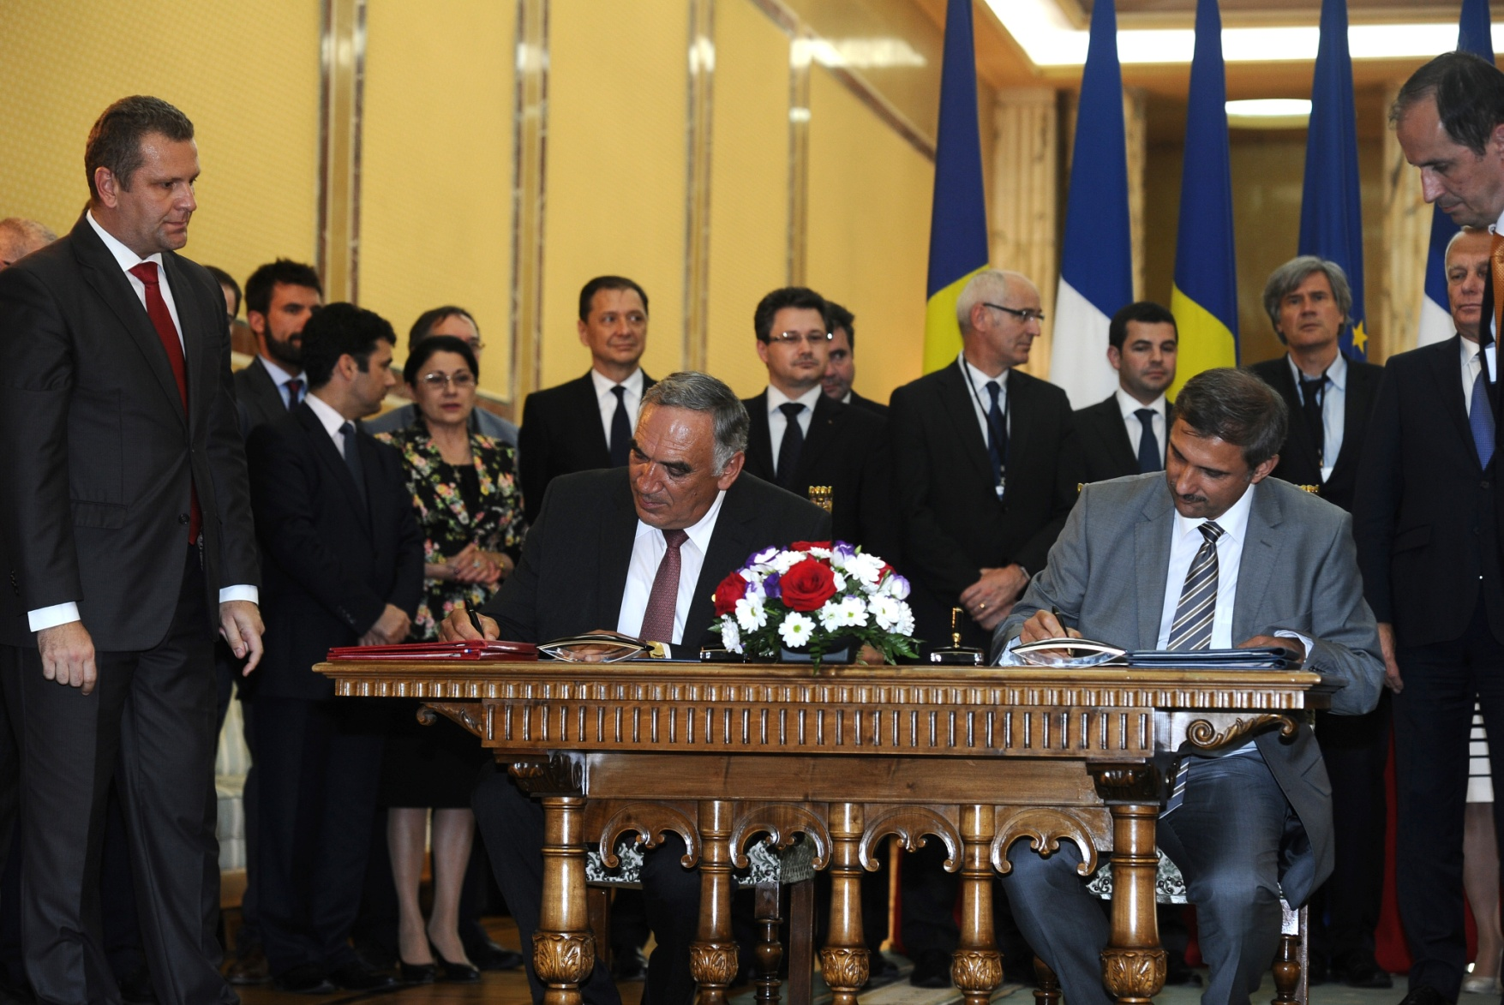
2x10PW Laser System
Thales Optronique SAS and S.C. Thales System Romania SRL
July 12th, 2013

Slide 13
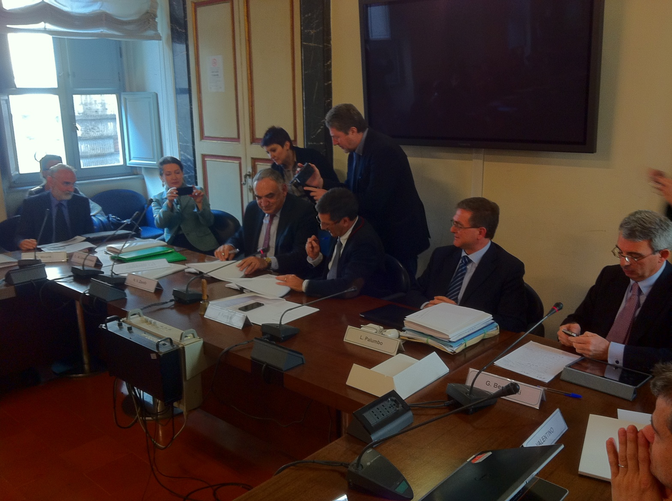
Gamma Beam System
EuroGammaS Association: Instituto Nazionale di Fisica Nucleare (Italy)
and Research Institutions and Companies from Italy, France, Sweden, UK, Germany, Denmark, Slovenia, Spain
March 19, 2014

Slide 14
ELI-NP Industrial Forum
Body promoting relationships, for mutual benefits,
with local and foreign companies
Consulting in elaborating the TDRs for experiments
and auxiliary equipment
Promotion of contractual research, technology transfer, etc.
Consulting services provided by ELI-NP experts
Creation of a cluster of high-tech companies in Magurele
14

Slide 15
ELI-NP Academic Forum
to secure the fulfillment of ELI-NP needs in terms of PhD students, junior researchers, engineers, and technicians (training programs, specific MSc and PhD programs, etc.);
to assure the education of engineers for the companies part of the high-tech cluster at Magurele;
to support the ELI-NP Project in the achievement of its objectives in terms of scientific excellence;
15

Slide 16
Recrutare Doctoranzi
Condiții:
Înscris la Doctorat în domenii Fizică/Inginerie de interes pentru ELI-NP
Rezultate excelente obținute în cursul studiilor absolvite
Fluență în limba Engleză
Admiterea:
Aplicații și documente: Conform regulament selecție www.eli-np.ro
Acordul Conducătorului de doctorat și al conducerii Școlii doctorale
Evaluarea
Dosar Interviu
Minim 70 puncte, maxim 100 puncte (pregătire profesională: 70 puncte, înțelegerea atribuțiilor postului: 30 puncte)

Slide 17
Oferta de angajare Doctoranzi
Contractul individual de muncă:
Normă întreagă – 8h/zi
Durată determinată: câte 1 an, până la finalizarea studiilor doctorale
Salarizare
Salariu net: 1000 euro/luna
Beneficii:
Asigurare medicală suplimentară (Furnizor privat de servicii medicale)
Facilități și suport cazare
Vechime recunoscută în activitatea de cercetare științifică
Oportunități:
Teză de doctorat la nivel de excelență în domeniul fizicii/ingineriei
Elaborare publicații științifice la standarde internaționale
Participare la manifestări științifice internaționale și la școli tineri cercetători
Deprinderi abilități de comunicare și redactare articole științifice

Slide 18
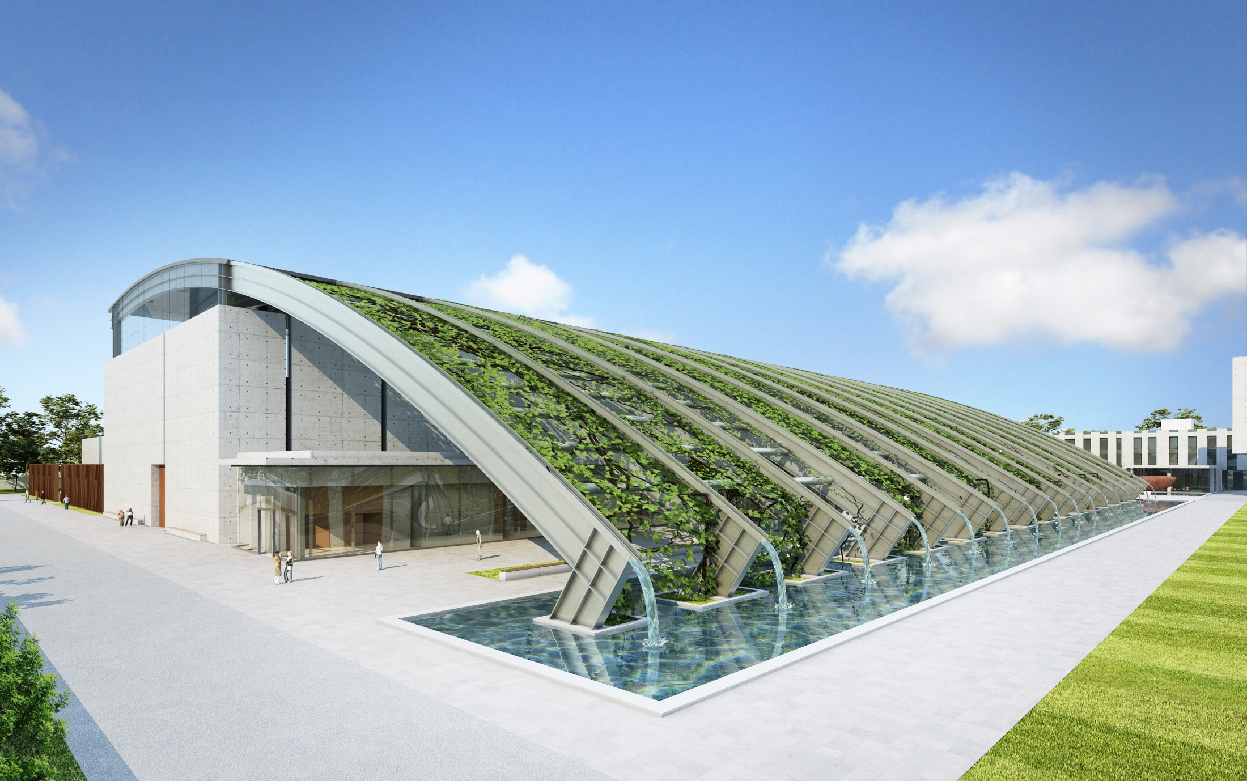
Thank you!

