Slide 1
ORIZONT 2020
Acţiunile Marie Skłodowska Curie
Eveniment organizat de Ministerul Educației Naționale, Universitatea din Craiova şi Enterprise Europe Network Craiova
Craiova, 05-06.06.2014

Slide 2
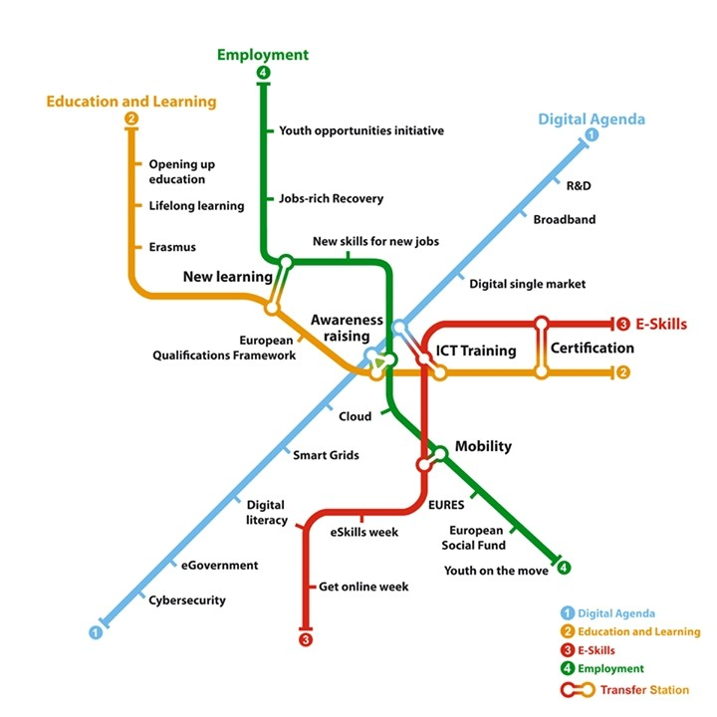
Marie Skłodowska Curie actions

Slide 3
Marie Skłodowska Curie actions
Overview
Schemes
Open calls
Application & Evaluation
Financial aspects

Slide 4
Marie Skłodowska Curie ACTIONS - OVERVIEW

Slide 5
Horizon 2020
Excellent Science
European Research Council (ERC)
Future and Emerging Technologies (FET)
Industrial Leadership
Leadership in Enabling and Industrial Technologies (LEIT) - ICT, KETs, Space
Innovation in SMEs
Societal Challenges
Health and Wellbeing
Food security
Research Infrastructures
Marie Skłodowska-Curie Actions (MSCA)
Security
Transport
Energy
Climate action
Societies
Access to Risk Finance
Widening Participation; Science with and for Society
European Institute of Innovation and Technology (EIT)
EURATOM
Joint Research Centre (JRC)

Slide 6
Achievements
Around 60.000 researchers financed since the creation of Marie Curie Actions
More than 10.000 PhD supported in FP7
38% of women among FP7 MCA fellows
SMEs play a major role, accounting for >50% of all businesses participating in IAPP and ITN
50-60% of the budget dedicated to research on societal challenges

Slide 7
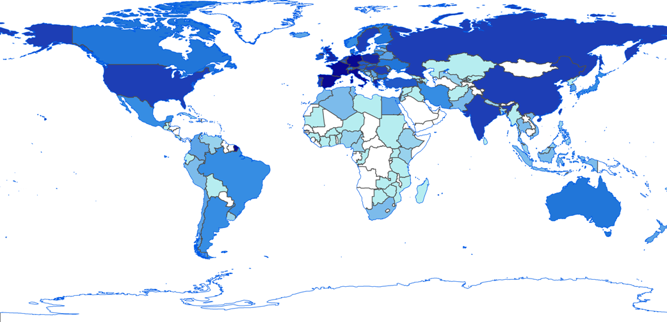
Achievements
Marie Curie researchers coming from all over the world (around 130 nationalities)

Slide 8
MSCA in Horizon 2020
MSCA objective
Ensure the optimum development and dynamic use of Europe’s intellectual capital in order to generate new skills and innovation
Total budget (2014-2020): € 6.162 billion (current prices)
Fostering new skills through excellent initial training of researchers
Nurturing excellence through cross-border and cross-sector mobility
Stimulating innovation through cross-fertilisation of knowledge
Increasing structural impact by co-funding the activities
Specific support and policy action

Slide 9
MSCA in Horizon 2020
Operates in a ‘bottom-up’ basis
Open to all research and innovation domains – from basic research to market take-up
Mobility is a key requirement
Aim: develop new knowledge / enhance skills of people behind research and innovation
Dissemination and public engagement through public outreach activities
Total budget: €6.2bn (compared with €4.7bn in FP7)

Slide 10
MSCA in Horizon 2020
Simplification and rationalisation of activities
Improved participation of businesses and other socio-economic actors
Increased possibility of portability of grants
Stronger emphasis on communicating results and on outreach activities

Slide 11
Marie Skłodowska Curie ACTIONS - schemes

Slide 12
MSCA Schemes
Horizon 2020
ITN | Innovative Training Networks (Early Stage Researchers)
IF | Individual Fellowships (Experienced Researchers)
RISE | Research and Innovation Staff Exchange (Exchange of Staff)
COFUND | Cofunding or regional, national and international programmes
NIGHT | Researchers’ Night

Slide 13
MSCA Schemes
Innovative Training Networks - ITN
Training Networks
European Industrial Doctorates
Joint Doctorates
Individual Fellowships - IF
Support for experienced researchers undertaking international and inter-sector mobility
Research and Innovation Staff Exchange - RISE
International and inter-sector cooperation through the exchange of staff
Co-funding of programmes - COFUND
Co-funding of regional, national and international programmes (doctoral programmes,fellowship programmes)
Researchers’ Night

Slide 14
Definitions
Early Stage Researcher (ESR)
At the time of recruitment (ITN) or secondment (RISE) by the host organisation, must be in the first 4 years (full-time research experience) of their research careers and have not been awarded a doctoral degree
Experienced Researcher (ER)
At the time of the call deadline (IF) or secondment (RISE) by the host organisation, must be in possession of a doctoral degree or have at least 4 years of full-time equivalent research experience
Academic sector
Includes universities (public and private), higher education institutions (public and private), non-profit research institutions (public and private), research foundations, research institutions associated to foundations, international European interest organisations
Non-academic sector
Includes any socio-economic actor not included in the academic sector
Mobility Rule:
At the time of the relevant deadline for submission of proposals, or recruitment/secondment by the host organisation, depending on the action, researchers shall not have resided or carried out their main activity (work, studies, etc) in the country of their host organisation for more than 12 months in the 3 years immediately prior to the reference date.”

Slide 15
Marie Skłodowska Curie ACTIONS - schemes
Innovative Training Networks (ITN)

Slide 16
Innovative Training Networks (itn)
“Aim to train a new generation of creative, entrepreneurial and innovative researchers, able to face current and future challenges and to convert knowledge and ideas into products and services for economic and social benefit”
Competitively selected joint research training/doctoral programmes implemented by partnerships of universities, research institutions, businesses, SMEs and other socio-economic actors from different countries across Europe (and beyond).
Focus on scientific/ technological knowledge through research on individual/personalised projects
Exposure to non-academic sector
Transferable skills training e.g. communication, research management, IP, ethics, societal outreach, entrepreneurship

Slide 17
Innovative Training Networks (itn)
MSCA - main EU programme for structured doctoral training
Dedicated to early-stage researchers (no ER recruitment)
Involving wide partnership of institutions from academic and non-academic sectors
Based on FP7 ITN experience
Addressing multiple dimension of mobility
Combining scientific excellence with innovation-oriented approach
Developing entrepreneurship and skills matching research labour market needs
Enhancing employability of researchers
Proposing innovative ways of doctoral training, such as industrial doctorates or joint doctorates

Slide 18
Innovative Training Networks (itn)
The ITN scheme consists of 3 strands:
European Training Networks
(minimum of 3 participants)
European Joint Doctorates
(at least 3 academic participants who can deliver a doctoral degree)
European Industrial Doctorates
(1 academic and 1 non-academic partner)
Other new features:
Participants defined as ‘academic’ and ‘non-academic’
Early stage researchers (ESRs) only
Innovative Doctoral Programme strand only through COFUND

Slide 19
Innovative Training Networks (itn)
Country 1
Country 1
Academia
Non-academia
Academia
Non-academia
Academia
Non-academia
Academia
PARTNER
ORGANISATIONS
Academia
Non-academia
Academia
Non-academia
Academia
Non-academia
Academia
Non-academia
Academia
Academia
Country 3
Country 2
Country 3
Country 2
European Training Networks
European
Joint
Doctorates
Academia
Non-academia
≥ 50%
Academia
Non-academia
European Industrial Doctorates
Non-academia
Academia
Country 1
Country 2

Slide 20
Innovative Training Networks (itn)
European Training Networks
At least three beneficiaries from different MS/AC
Maximum 540 researcher-months
European Joint Doctorates
Doctoral programme enrolment mandatory
Joint governance, admission, selection, supervision, monitoring and assessment mandatory
European Industrial Doctorates
Doctoral programme enrolment mandatory
Joint governance, admission, selection, supervision, monitoring and assessment mandatory
Award of joint, double or multiple doctoral degree mandatory
At least one academic and one non-academic partner from different MS/AC
Maximum 180 researcher-months
Maximum 540 researcher-months
At least three beneficiaries from different MS/AC
Doctoral programme enrolment optional

Slide 21
Innovative Training Networks (itn)
ITN activities
Four year programme (max three year support for each ESR)
Activities include:
Research and innovation
Secondments, placements
Summer schools

Slide 22
Marie Skłodowska Curie ACTIONS - schemes
Individual Fellowships (IF)

Slide 23
Individual Fellowships
“Aim to enhance the creative and innovative potential of experienced researchers wishing to diversify their individual competence in terms of skill acquisition at multi- or interdisciplinary level through advanced training, international and intersectoral mobility”
Supports Experienced Researchers only
Opportunities to acquire new knowledge and work on research in a European context, or outside Europe
Specific support for return and reintegration of researchers to Europe who have previously worked here
Supports career restart for individuals with high potential

Slide 24
Individual Fellowships
Opportunities for international and inter-sector mobility of ER to facilitate career moves
Encompass all types of mobility:
European Fellowship
Global Fellowship
Reintegration Panel
Career Restart Panel to resume a research career after a break
Secondments (optional) embedded in the career development – to take place within Europe (3 or 6 months included in the total duration)
Special focus on inter-sector collaboration

Slide 25
Individual Fellowships
European Fellowships
From any country to MS/AC
Global Fellowships
Secondment from MS/AC to third country
Mandatory 12 month return phase in Europe (not subject to mobility rule)
12-24 months
12-24 months plus 12 month return phase
Separate multi-disciplinary panels for career restart * and reintegration**
Mobility rule for CAR and RIG: “researcher has not resided or carried out their main activity in the country of their host organisation for more than 3 years in the 5 years immediately prior to the relevant deadline”
*) AND “researcher has not been active in research for at least 12 months”
**) AND “researcher has previously been active in Europe for at least five consecutive years”

Slide 26
Individual Fellowships
Optional intersectoral secondment that should significantly add to the impact of the research project
Must take place in a MS/AC
Must occur during the fellowship
Secondment phase can be a single period or divided into shorter mobility periods
For a fellowship > 18 months, secondment phase may be up to 6 months
For a fellowship ≤ 18 months, secondment phase may be up to 3 month

Slide 27
Marie Skłodowska Curie ACTIONS - schemes
Research and Innovation Staff Exchange (RISE)

Slide 28
Research and Innovation Staff Exchange (RISE)
“Aim to promote international and inter-sector collaboration through research and innovation staff exchanges, and sharing of knowledge and ideas from research to market (and vice-versa) for the advancement of science and development of innovation”
Should involve institutions from the academic and non-academic sectors (particularly SMEs) based in MS/AC and/or third countries
Development of joint research and innovation project partnerships
Knowledge sharing via international and/or inter-sector mobility through two way secondments of (ESRs /ERs/support staff) with built-in return mechanism
Exchanges between MS/AC only: secondments must be inter-sectoral
Exchanges between MS/AC and third countries: secondments can be same sector and/or intersectoral

Slide 29
Research and Innovation Staff Exchange (RISE)
New type of exchange of staff action to stimulate transfer of knowledge and sharing of ideas
Flexible inter-sector and international exchanges of highly skilled research and innovation staff
Based on a common research and innovation project
Secondments only, no recruitment foreseen
Single eligibility rule for partnership consortia
Exchanges between institutions within Europe cover only inter-sector secondments
Exchanges with institutions from outside Europe can be both inter-sector and within the same sector
No support for secondments between institutions located outside Europe

Slide 30
Research and Innovation Staff Exchange (RISE)

Slide 31
Research and Innovation Staff Exchange (RISE)
Participants must be from at least three different countries, at least two of which are MS/AC
If all participants in same sector one participant country must be a third country
Secondment period - 1 to 12 months- does not need to be continuous
Activities of the programme
Joint research and innovation
Networking
Sharing of knowledge
Career development of staff
New skills acquisition
Workshops, Conferences

Slide 32
Marie Skłodowska Curie ACTIONS - schemes
Cofunding or regional, national and international programmes (COFUND)

Slide 33
Cofunding or regional, national and international programmes (COFUND)
“Aims at stimulating regional, national or international programmes to foster excellence in researchers’ training, mobility and career development, spreading the best practices of MSCA”
Supports new or existing programmes for international, inter-sectoral and interdisciplinary research training and transnational and cross-sector mobility of researchers
Two streams
Doctoral programmes
Fellowship programmes

Slide 34
Cofunding or regional, national and international programmes (COFUND)
Doctoral programmes
Supports ESRs
Fellowship programmes
Supports ERs
Regular selection rounds allowing fair competition
Doctoral enrolment mandatory
Training and secondment opportunities with partners, particularly the non-academic sector will be advantageous
Not open to permanent employees of the host organisation
Cross-sectoral mobility encouraged

Slide 35
Marie Skłodowska Curie ACTIONS - schemes
Researchers’ Night (NIGHT)

Slide 36
Researchers’ Night (NIGHT)
“Aims to bring the researchers closer to the public at large and to increase public awareness of the research and innovation activities and the impact of researchers’ work”
European Researchers’ Night takes place on the last Friday of September annually
Events can start on early Friday afternoon and last until early Saturday morning
Participants can be any legal entity in MS/AC and/or a partnership at regional, national or international level
Funding will cover two editions of the Night (2014 and 2015) but funding for one edition only may be considered
Involvement of researchers funded by FP7/Horizon 2020 encouraged

Slide 37
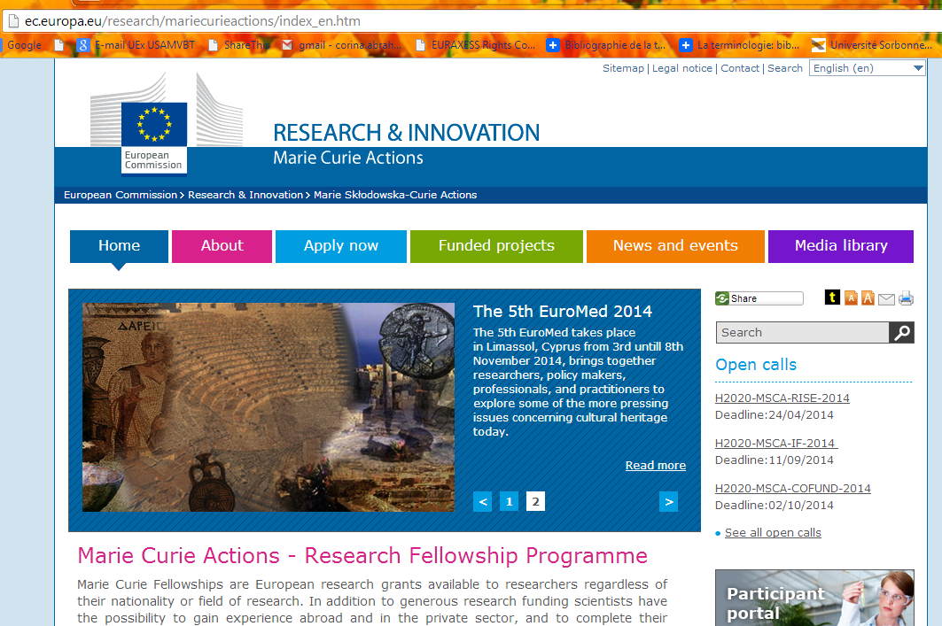
MSCA website

Slide 38
Marie Skłodowska Curie ACTIONS – open calls

Slide 39
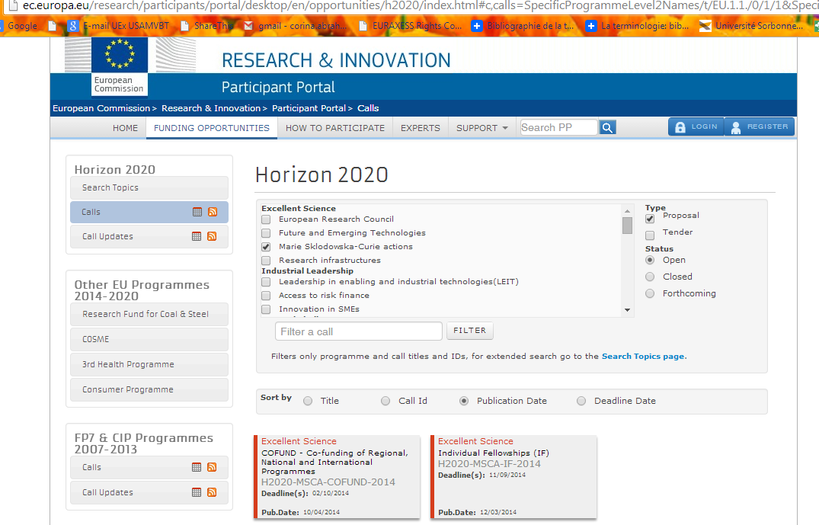
Msca - Open calls

Slide 40
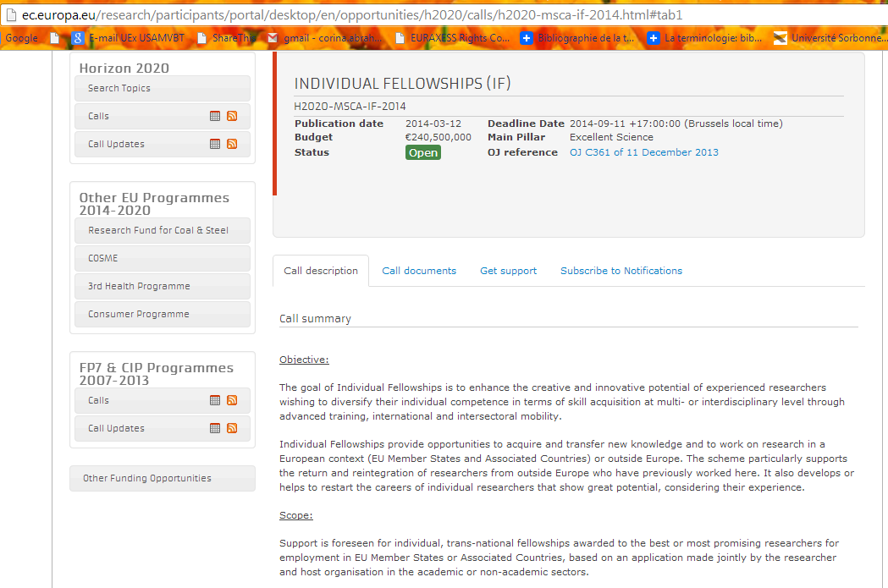
Msca - Open calls

Slide 41
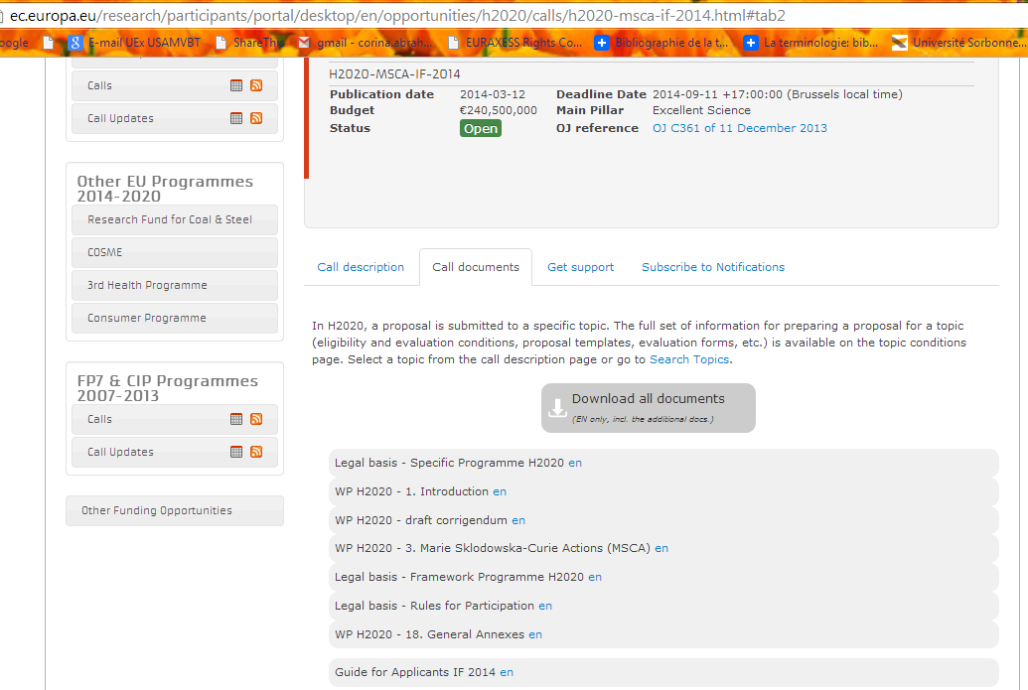
Msca - Open calls

Slide 42
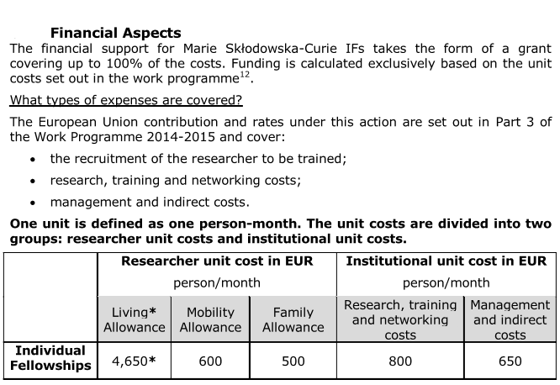
Msca - Open calls
* This amount is adjusted through the application of a correction coefficient for the cost of living according to the country in which the host organisation is located.

Slide 43
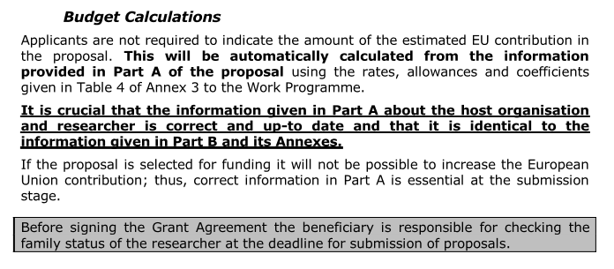
Msca - Open calls

Slide 44
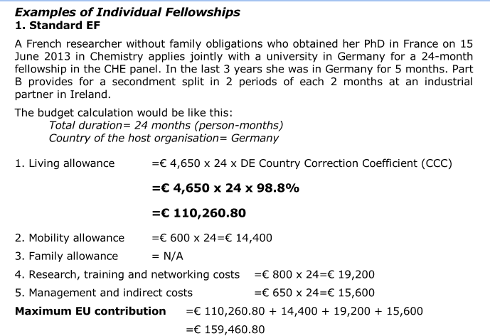
Msca - Open calls

Slide 45
Msca - timetable
Call | Opens | Budget
ITN 2015 | 2 Sep 2014 | 370 M
RISE 2015 | 6 Jan 2015 | 80 M
IF 2015 | 12 Mar 2015 | 213 M
COFUND 2015 | 14 Apr 2015 | 80 M
Note: draft and subject to change

Slide 46
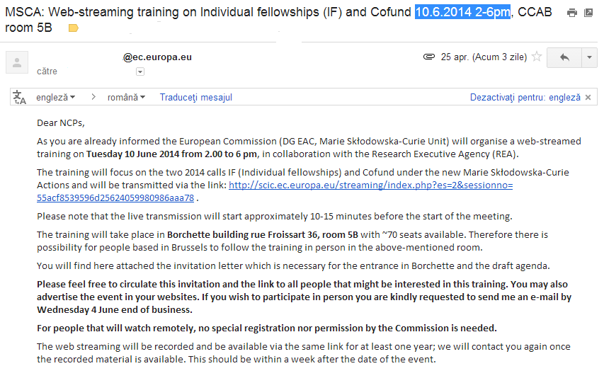
Msca – webstreaming 10.06.2014, 2-6pm

Slide 47
Marie Skłodowska Curie ACTIONS – financial aspects

Slide 48
Financial aspects
ITN | IF | RISE | COFUND
ESR living allowance €2,900/month + co-efficient ESR mobility allowance €600/month ESR family allowance €500/month Host research, training and networking €1,800/person/ month Host management and overheads €1,200 /person/ month | ER living allowance €4,650 / month + co-efficient ER mobility allowance €600/month ER family allowance €500/month Research, training and networking €800/person/ month Management and overheads €650/person/ month | Secondment travel & subsistence €2,000/person/ month Research, training and networking €1,800/person/ month Management and overheads €700/person/ month | ESR living allowance Salaried €2,450 - €3,500/month or Stipend: €1,225 - €1,750/month ER living allowance Salaried: €3,675 - €5,250/month or Stipend: €1,225 - €1,750/month Management €650/person/ month Host needs to cover all other costs and EC will pay up to 50% of total eligible costs

Slide 49
Financial aspects - Structure - eligibility
Categories of eligible costs Marie Skłodowska-Curie action | Costs of researchers/seconded staff member (1) |  |  |  | Institutional costs (2)
 | Living allowance (a) | Mobility allowance (b) | Family allowance (c) | Top-up allowance (d) | Research, training and networking costs (a) | Management and indirect costs (b)
ITN | Unit cost per person/month | Unit cost per person/month | Unit cost per person/month | Ineligible | Unit cost per person/month | Unit cost per person/month
IF | Unit cost per person/month | Unit cost per person/month | Unit cost per person/month | Ineligible | Unit cost per person/month | Unit cost per person/month
RISE | Ineligible | Ineligible | Ineligible | Unit cost per person/month | Unit cost per person/month | Unit cost per person/month
COFUND | Unit cost per person/month (one for early-stage researchers and one for experienced researchers) | Ineligible | Ineligible | Ineligible | Ineligible | Unit cost per person/month (indirect costs not covered)

Slide 50
Financial aspects - Structure - amounts
Categories of eligible costs Marie Skłodowska-Curie action | Costs of researchers/seconded staff member (1) |  |  |  | Institutional costs (2)
 | Living allowance (a) | Mobility allowance (b) | Family allowance (c) | Top-up allowance (d) | Research, training and networking costs (a) | Management and indirect costs (b)
ITN (100%) | 3 110 | 600 | 500 | -- | 1 800 | 1 200
IF (100%) | 4 650 | 600 | 500 | -- | 800 | 650
RISE (100%) | -- | -- | -- | 2 000 | 1 800 | 700
COFUND (50%) | ESR: 3 710 ER: 5 250 | -- | -- | -- | -- | 650
Living allowances:
ITN/IF - ER FP7 average; ESR: 66,9% of ER (MORE2)
COFUND: sum of LA/MA
Mobility allowance: FP7 average
Family allowance: FP7 average, but increased to support in particular women (MORE2)
Top-up allowance: FP7 average, but increased (FP7 Interim Evaluation)
R, T & N costs: FP7 rates of 2011-2013 (FP7 Interim Evaluation)
M & I costs: FP7 average for multi-beneficiary projects and COFUND

Slide 51
Marie Skłodowska Curie ACTIONS – Application Process

Slide 52
Application Process
Applications on line through the ECAS Participant Portal
Apply to specific discipline panel
Evaluation panels
Chemistry (CHE)
Social Sciences and Humanities (SOC)
Economic Sciences (ECO)
Information Science and Engineering (ENG)
Environment and Geosciences (ENV)
Life Sciences (LIF)
Mathematics (MAT)
Physics (PHY)
Additional multidisciplinary panels for ITNs
European Industrial Doctorates (EID)
European Joint Doctorates (EJD)
Additional multidisciplinary panel for IFs
Career Restart Panel
Reintegration Panel

Slide 53
Award Criteria
Experts will evaluate on the basis of following criteria:
Excellence 50%
Impact 30%
Quality and efficiency of the implementation 20%
Templates of the forms that experts use to evaluate proposals are available on the topic conditions pages for each call.

Slide 54
Award Criteria
Evaluation scores awarded for each criteria from 0 to 5
Each award criterion has a weighting
Total score is subject to a threshold of 70%
Proposals ranked
Proposals funded in ranking order
Evaluation summary reports provided
No restrictions on re-application

Slide 55
INFO
Marie Curie Actions Website
http://ec.europa.eu/mariecurieactions
Horizon 2020
http://ec.europa.eu/research/horizon2020

Slide 56
SUCCES !
Corina ABRAHAM-BARNA
c.g.abraham.barna@gmail.com

